Slide 1
Nick Leonard | Anna Ostberg | Aditya Sharma | Mike Sparandara | Adilakshmi Veerubhotla

Slide 2
Starting Out
Research tells us:
people have no problems finding recipes
people have no problems saving recipes
people bring technology into the kitchen to use while cooking
people use technology while at the grocery store
Nick Leonard | Anna Ostberg | Aditya Sharma | Mike Sparandara | Adilakshmi Veerubhotla

Slide 3
What’s Out There
finding recipes
commenting
saving recipes
filtering
rating recipes
social networking
meal planning
Nick Leonard | Anna Ostberg | Aditya Sharma | Mike Sparandara | Adilakshmi Veerubhotla

Slide 4
What We’re Keeping
finding recipes
commenting
saving recipes
filtering
rating recipes
social networking
meal planning
Nick Leonard | Anna Ostberg | Aditya Sharma | Mike Sparandara | Adilakshmi Veerubhotla

Slide 5
What We’re Adding
finding recipes
dashboard
commenting
saving recipes
filtering
timeline
rating recipes
social networking
meal planning
hands-free interaction
streamlined recipe steps
Nick Leonard | Anna Ostberg | Aditya Sharma | Mike Sparandara | Adilakshmi Veerubhotla

Slide 6
Our Focus
Target Audience:
techno-savvy cooks of any experience level
Goal:
Optimize the use of the web in the kitchen as a cooking aid
Considerations:
support the flow of cooking
coordinate multiple dishes being cooked in parallel
manage time effectively
Nick Leonard | Anna Ostberg | Aditya Sharma | Mike Sparandara | Adilakshmi Veerubhotla

Slide 7
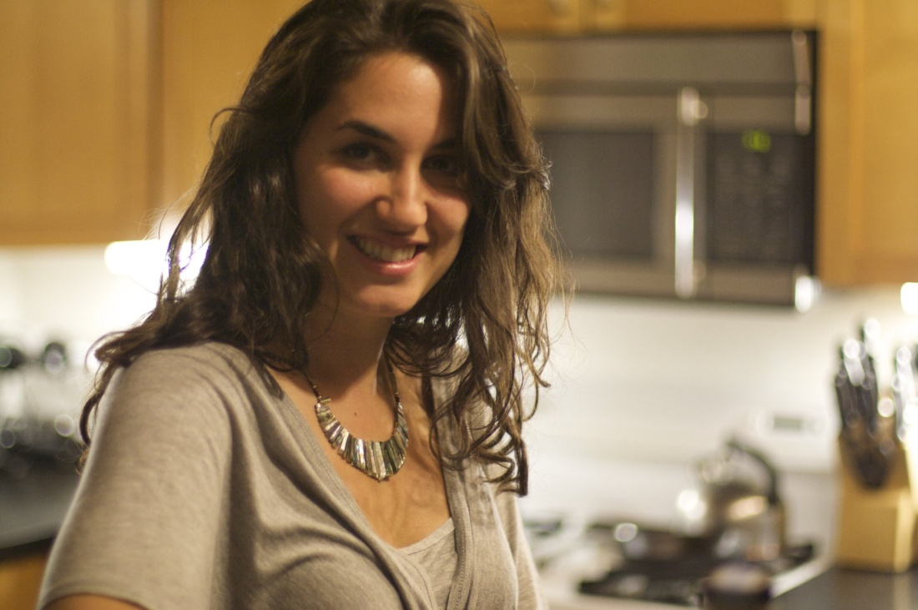
Jane Miller
26 years old
Lives in Chicago
Works as a 4th grade teacher
Novice cook, but wants to learn
Currently eats frozen LeanCuisine lunches most days, and would like to start cooking her own lunches instead
Always has her BlackBerry Pearl with her
Has a Macbook
Primarily grocery shops at Jewel, but likes to get a few things from Whole Foods
Nick Leonard | Anna Ostberg | Aditya Sharma | Mike Sparandara | Adilakshmi Veerubhotla

Slide 8
Our Solution
Spatula
dashboard view for use while cooking
provide user with clearly delineated steps
provide tips for novice users
hands-free use of the dashboard while cooking
voice commands
ChickenDance: unique interaction technique for hands-free use
Nick Leonard | Anna Ostberg | Aditya Sharma | Mike Sparandara | Adilakshmi Veerubhotla

Slide 9
Walkthrough
Nick Leonard | Anna Ostberg | Aditya Sharma | Mike Sparandara | Adilakshmi Veerubhotla

Slide 10
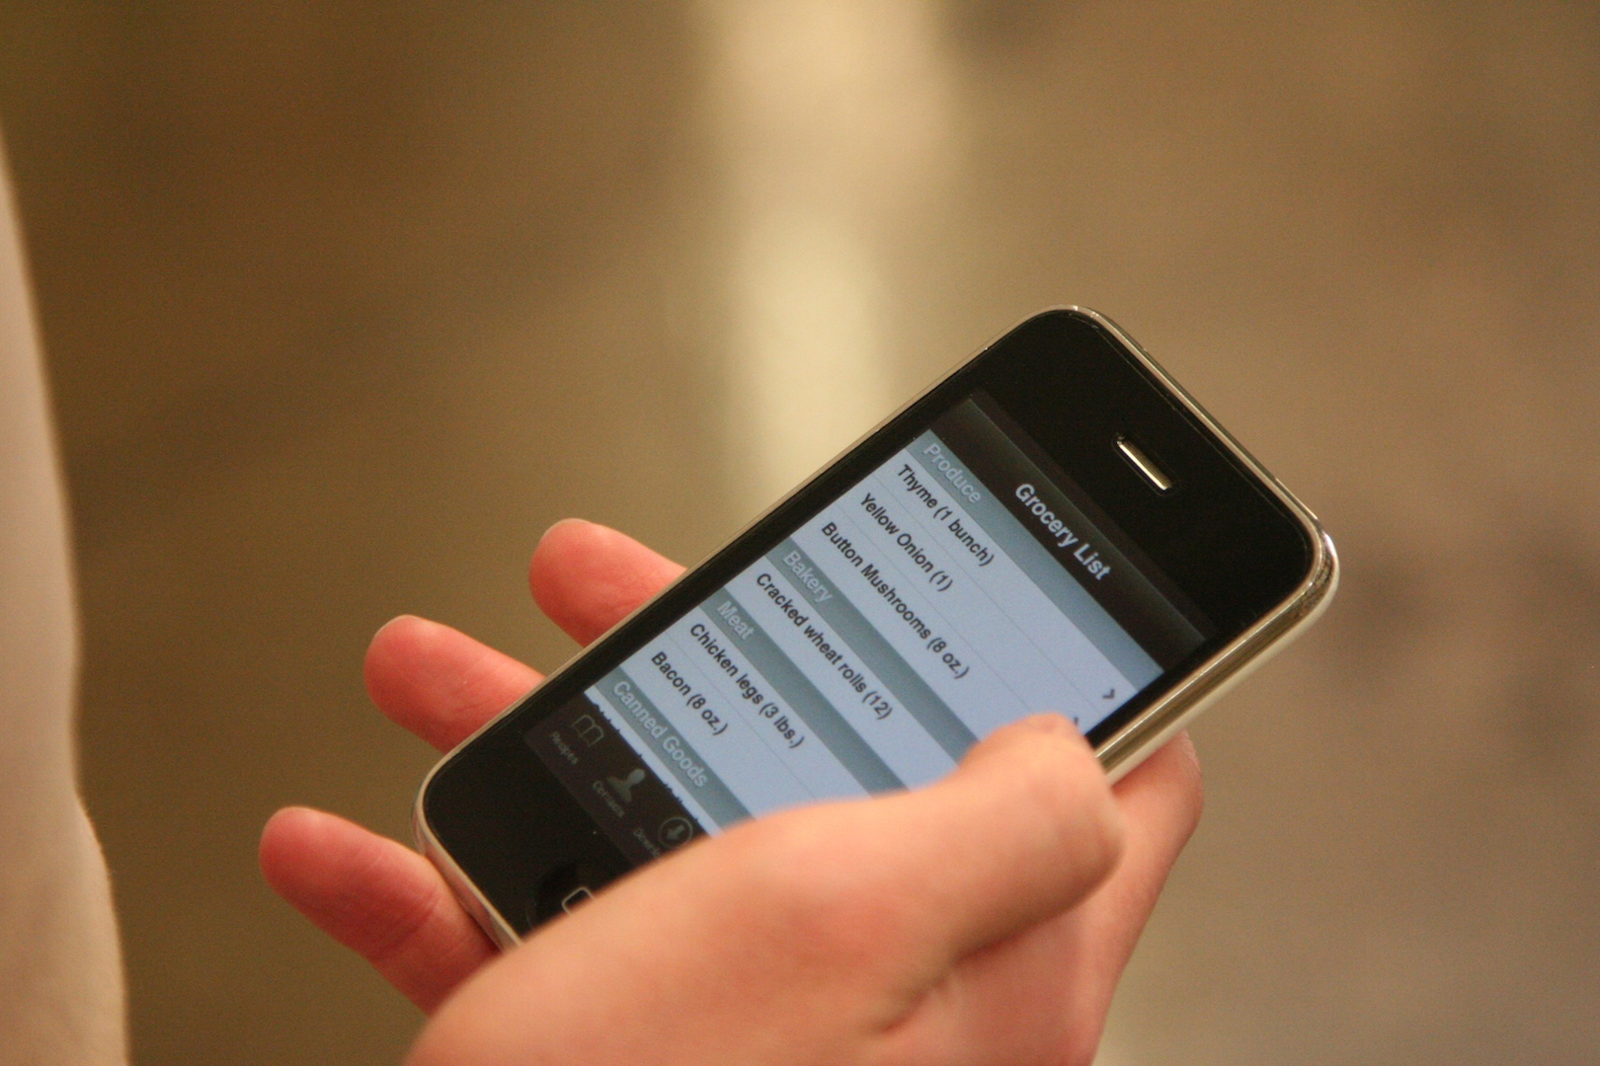
Grocery List

Slide 11
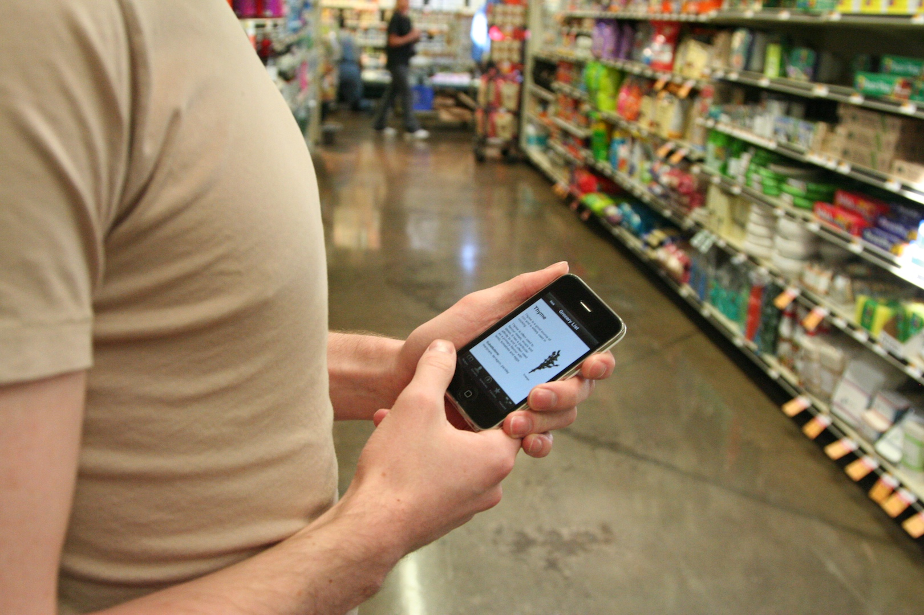
Grocery List

Slide 12
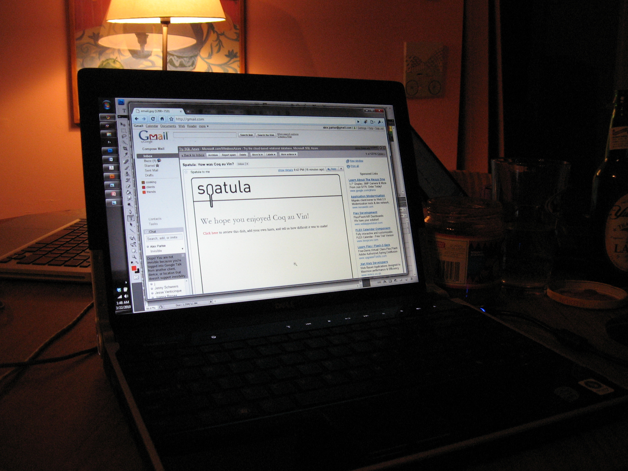
Email Reminders

Slide 13
ChickenDance
Now with 100% less salmonella!
Enable use of the dashboard while cooking
Elbows as an input tool
No need for extra hand washing between steps
No greasy fingerprints
Many possible combinations for input
(e.g. one elbow; swipes; holds)
Patent pending
Nick Leonard | Anna Ostberg | Aditya Sharma | Mike Sparandara | Adilakshmi Veerubhotla

Slide 14
Video Demo
Nick Leonard | Anna Ostberg | Aditya Sharma | Mike Sparandara | Adilakshmi Veerubhotla

