Slide 1
What Happened
Last Night?
A Collection of Shared Experiences
Caitlinn Cork
Oren Kravetz
Prerna Ramesh
Spencer Sugarman

Slide 2
User Research
Brick & Mortar
  Bartenders can’t speak about what goes on in their bars
Retrospectives
  Lots of crazy, drunken stories
  Stories involving both groups and individuals

Slide 3
User Research Trends
People remember different things and piece together the story later
The interaction takes place primarily offline
People like reading embarrassing stories about other people

Slide 4
Experts & Novices
Or, in other words:
  People who were there
  vs.
  People who weren’t

Slide 5
Feedback
Privacy Issues
Inclusion of other (non-drunken) memories & experiences
Screening of non-interesting stories
Notes:
What kind of stories are recommended;

Slide 6
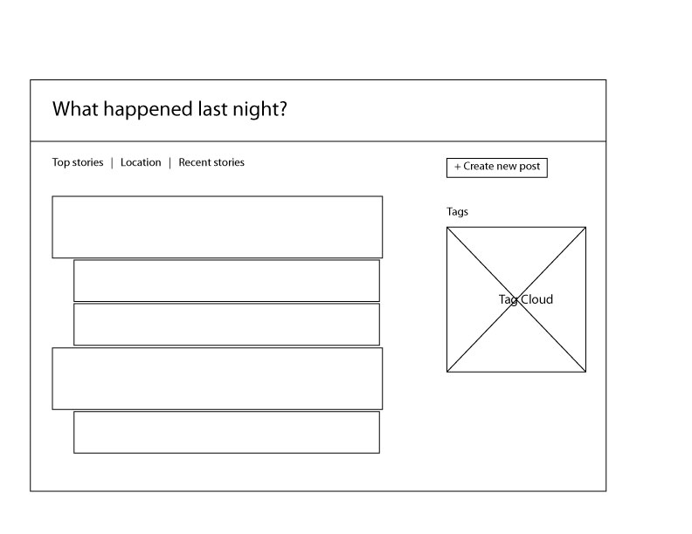
Wireframes

Slide 7
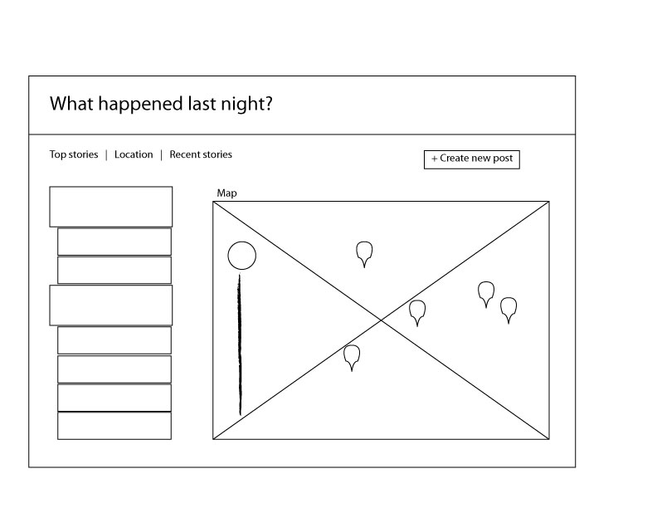
Wireframes

Slide 8
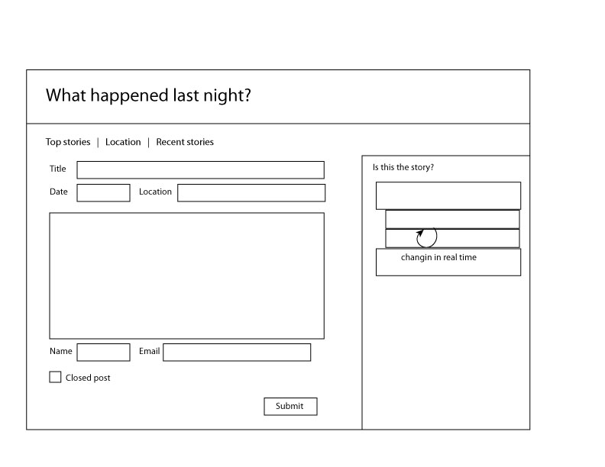
Wireframes

Slide 9
Scenarios
First Scenario
Scenario the Second
Scenario III: Revenge of the Scenarios

Slide 10
Features
Public & Private stories
Commenting
Rating
Reporting
View by popular, new, map

Slide 11

Demonstration

