Slide 1
Serenity
Caitlinn Cork, Vaishali Jain, Deanna Miller, Adi Veerubhotla

Slide 2
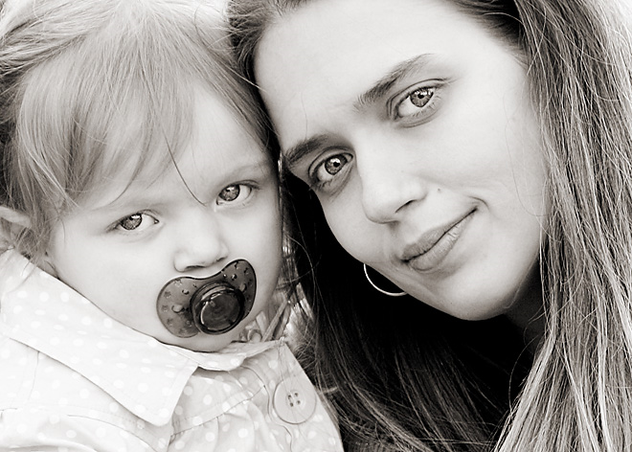
Persona: Rachael Wagner
Rachael Wagner is a 37 year old lawyer in downtown New York. She is a single mother with a baby girl, Lily, who just turned three in December. Last year, immediately after her divorce, Rachael moved to Long Island, NY to be closer to her parents. Rachel uses both a day care, and her family, to help her out with Lily during the weekdays.
Rachael’s desk, covered in paperwork , has a picture of Lily from her first birthday which she has been meaning to update for the longest time. She typically orders lunch from the deli downstairs, and eats at her desk if she has time. She is often running back and forth from court, or client meetings, and relies on her iPhone to keep her organized.
After work, Rachael picks Lily up at her parents house, and will try to read her a bed time story if Lily is still awake when they get home. On the weekends she spends her time taking her daughter to the park or play dates with other friends. She often uses her blackberry’s camera to take pictures of Lily doing silly things.
Rachael Wagner
Age: 37
Profession: lawyer
Martial Status: divorced
Single mother of toddler (Lily)
Relies heavily on family for babysitting
Spends weekend with Lily at park
Always on the move
No time for herself
Uses her blackberry as an organizer/came

Slide 3
Rachael’s Typical Morning

Slide 4
Our Purpose
Our Goal:
to create an application that will allow single working moms to relax in the little time they have for themselves
Intentions:
Our intent is NOT to remind the user of their already hectic life, but to give them an opportunity to escape from it so that they can handle their tasks with a healthy state of mind.

Slide 5
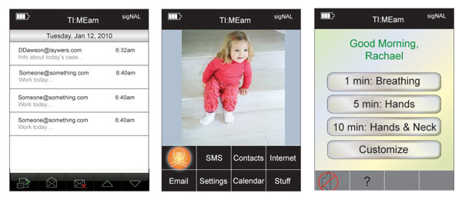
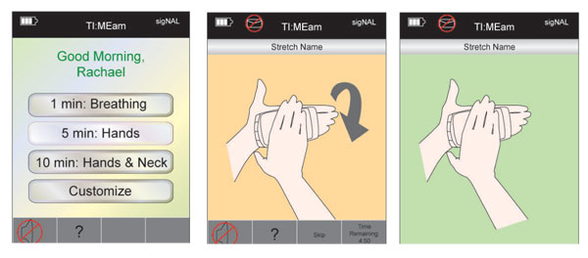
Our First Iteration

Slide 6
Design Iteration
Changed icon design
Changed the interaction style to match the application’s goals
Made application more human centered
Changed names of exercises to accurately evoke a more peaceful mood
Provided additional feedback during exercises

Slide 7
Main Features
Allows user to customize their experience
Lets user choose which part of their body they want to exercise
User can choose music to listen to during exercise from application’s presets, or personal iTunes
Syncs with user’s iCalendar (if they choose)
Provides narration and on-screen diagrams

Slide 8
Final Demonstration

Slide 9
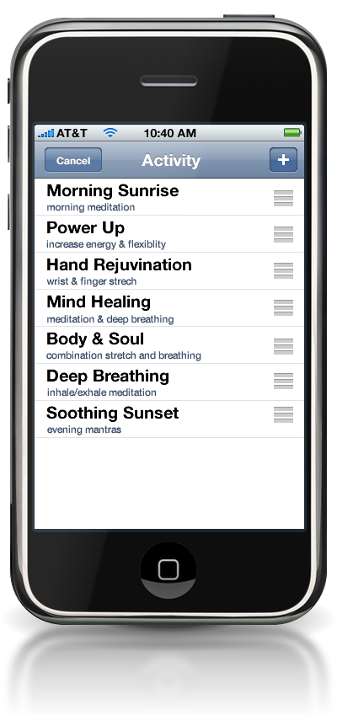
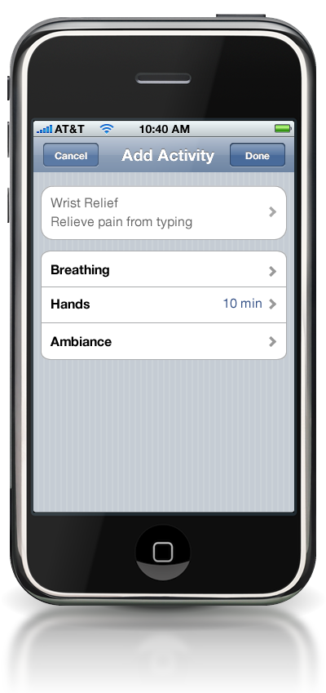
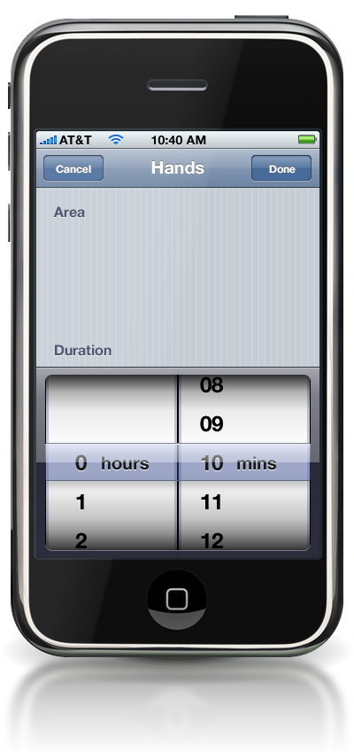
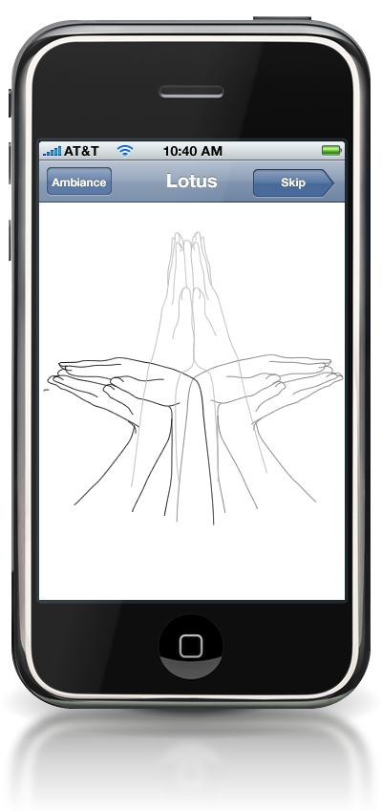
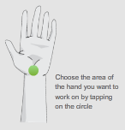
Flash Demonstration

