Slide 1
Window to the Past
M. Azim Ali : Tom Bolster : Nate Colker : Sin-Young Park

Slide 2
Jones & Laughlin Steel Co.
Notes:
One of the largest iron and steel manufacturers
This Steel Company plant that helped win two world wars and make the United States a great industrial power. With the advent of cheaper foreign steel starting in the late 1970s and accelerating in the 1980s the massive mill and factory complex was idled in the mid-1980s.

Slide 3
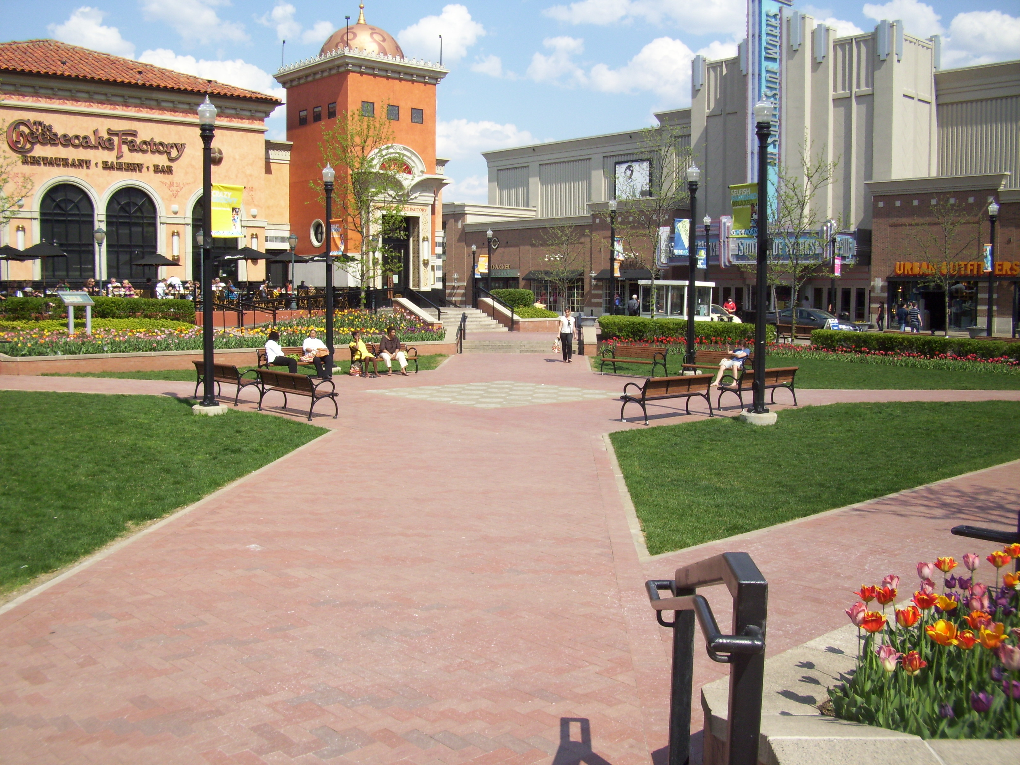
South Side Works
Notes:
Urban, outdoor mall that sits on a historic Pittsburgh landmark

Slide 4
Problem Description
How can we enrich the time spent in this space by taking advantage of the historic aspect of the site?
Notes:
Urban, outdoor mall that sits on a historic Pittsburgh landmark

Slide 5
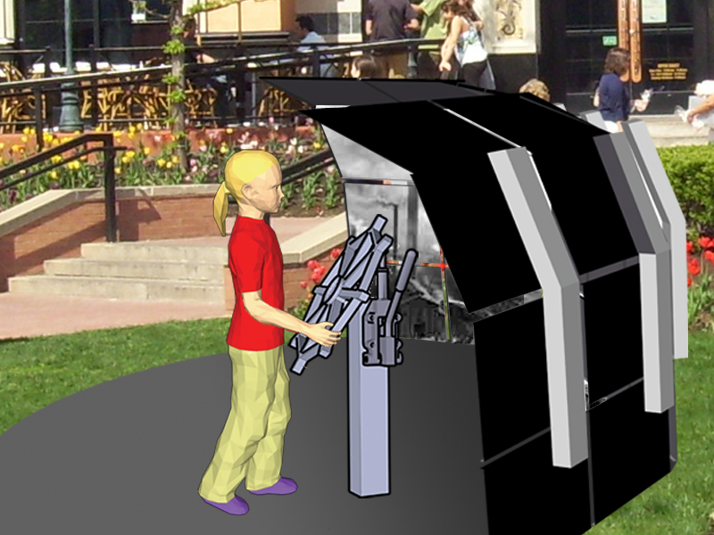
Sneak Peek
Notes:
Sneak Peek
Interactive kiosk that will allow users to experience what used to be in this space before the redevelopment

Slide 6
Process

Slide 7
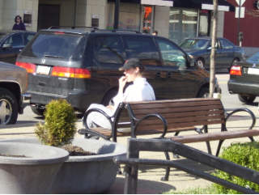
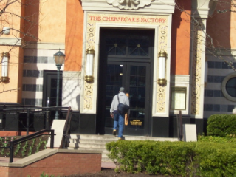
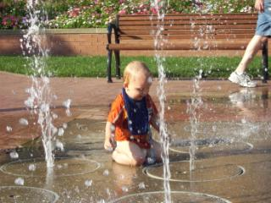
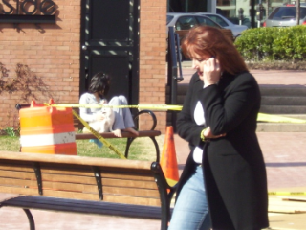
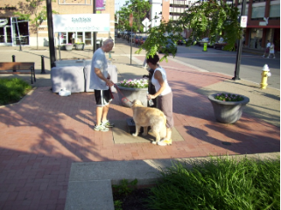
Direct Observation
Notes:
Who uses this space?
Why are they there?
What are they doing?
Going to the restaurants,
Enjoying the sun,
Waiting for others,
Passing through,
Walking the dog,
Playing in the fountain

Slide 8
Direct Observation
Notes:
Static placards
History of the J & L Steel Company
The way they made their steel
How this area impacted Pittsburgh, and the country during the industrial revolution
Great discovery for our project; preliminary concept validation

Slide 9
Concept Generation
Physical Form

Slide 10
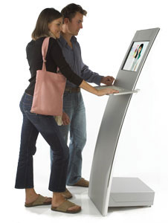
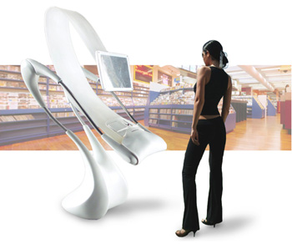
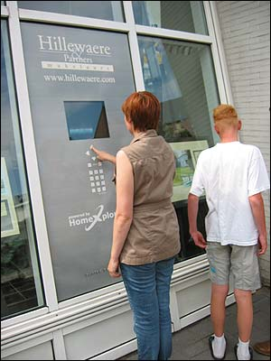
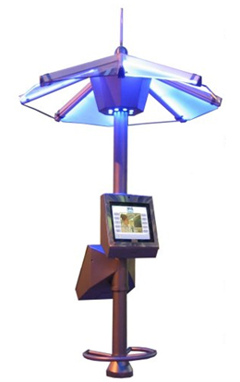
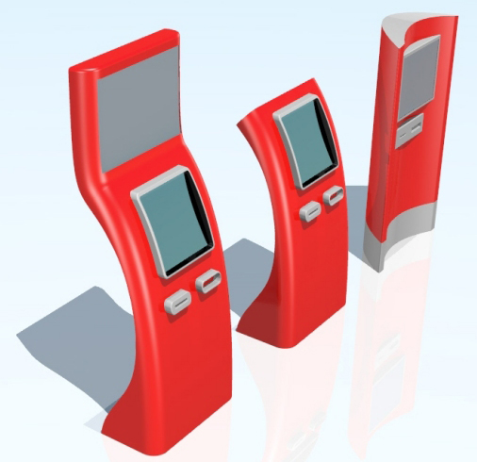
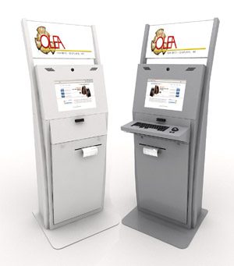
Secondary Research
Notes:
We knew we wanted to immerse out users in ‘what used to be here’
Started off by investigating some possible physical form factors

Slide 11
‘MS Paint’
Notes:
First concept
Screen connected to a pole
Rotates around the center
Sense the current temperature
Shows images of the space during the opposite season
Gives off hot / cold air to change the environment

Slide 12
‘The Robotic Arm’
Notes:
Pneumatic arm
Touch screen & dial
Direction & orientation sensor
Proximity sensor so it does not hit anyone as it moves
Pressure sensors to assist with movement
Ambient light

Slide 13
‘Rotate Around Pole’
Notes:
Flexible Arm
Canopy to shield users from the weather
Speakers and LEDs
Ambient Sound
Climate control

Slide 14
‘The Cylinder’
Notes:
Completely enclosed
Keyboard / mouse along with touch screen
Printer (movie tickets?)

Slide 15
‘The Flexible Hose Arm’

Slide 16
‘The Bendy Straw’

Slide 17
Concept Generation
Scenarios

Slide 18
Purchase Movie Tickets
Notes:
Couple wants to go to a movie
Theater is crowded, long line outside
See the kiosk and are intrigued
Buy tickets, avoid line

Slide 19
Restaurant Waitlist
Notes:
Couple is sitting in the Town Square area in front of the Cheesecake Factory
Curious about the kiosk, so they approach to see what the deal is
Points the kiosk at the restaurant, system shows him the current waitlist
Sees that he still has 40 minutes and decides to take a walk with his wife

Slide 20
Opposite Weather
Notes:
Person is waiting for friends outside the movie theater
Is uncomfortable because he is so hot
Sees a nice wintery scene being displayed on the kiosk across the way
Walks over and notices cool air being emitted, and the handles are also cold
Cycles through some images and doesn’t realize how quickly time has passed when his friends arrive

Slide 21
Historical Views
Notes:
Junior high school student is exploring Southside Works for a class report
Sees the kiosk and is intrigued by the display
Selects the Window to the Past option from the menu
Rotates the screen to see the area from different angles
Turns the dial to see different time periods

Slide 22
Dancing
Notes:
The kiosk has been idle for several minutes
Enters ‘Attract Mode’
Rotates itself to ‘look at’ people who are in the area
Cycles through images and intrigues passersby

Slide 23
Concept Validation
Speed Dating

Slide 24
Feedback – Form Factor
Robotic Arm
Rotate Around Pole
Cylinder
Flexible Hose Arm
Bendy Straw
Notes:
Single, robotic-looking ‘claws’ were not approachable
Don’t like having to physically move the display
Can the cylinder be transparent? Not completely enclosed.

Slide 25
Feedback – Form Factor
Robotic Arm
Rotate Around Pole
Cylinder
Flexible Hose Arm
Bendy Straw
Notes:
Single, robotic-looking ‘claws’ were not approachable
Don’t like having to physically move the display
Can the cylinder be transparent? Not completely enclosed.

Slide 26
Feedback – Scenarios
Movie Tickets
Restaurant Waitlist
Opposite Weather
Window to the Past
Dancing
Notes:
Movie tickets is not useful; automatic kiosks already exist
Restaurant waitlist is not useful; How is this different from a beeper?
Dancing is ‘creepy’
Liked the historical aspect
Liked the opposite weather

Slide 27
Feedback – Scenarios
Movie Tickets
Restaurant Waitlist
Opposite Weather
Window to the Past
Dancing
Notes:
Movie tickets is not useful; automatic kiosks already exist
Restaurant waitlist is not useful; How is this different from a beeper?
Dancing is ‘creepy’
Liked the historical aspect
Liked the opposite weather

Slide 28
Concept Revision

Slide 29
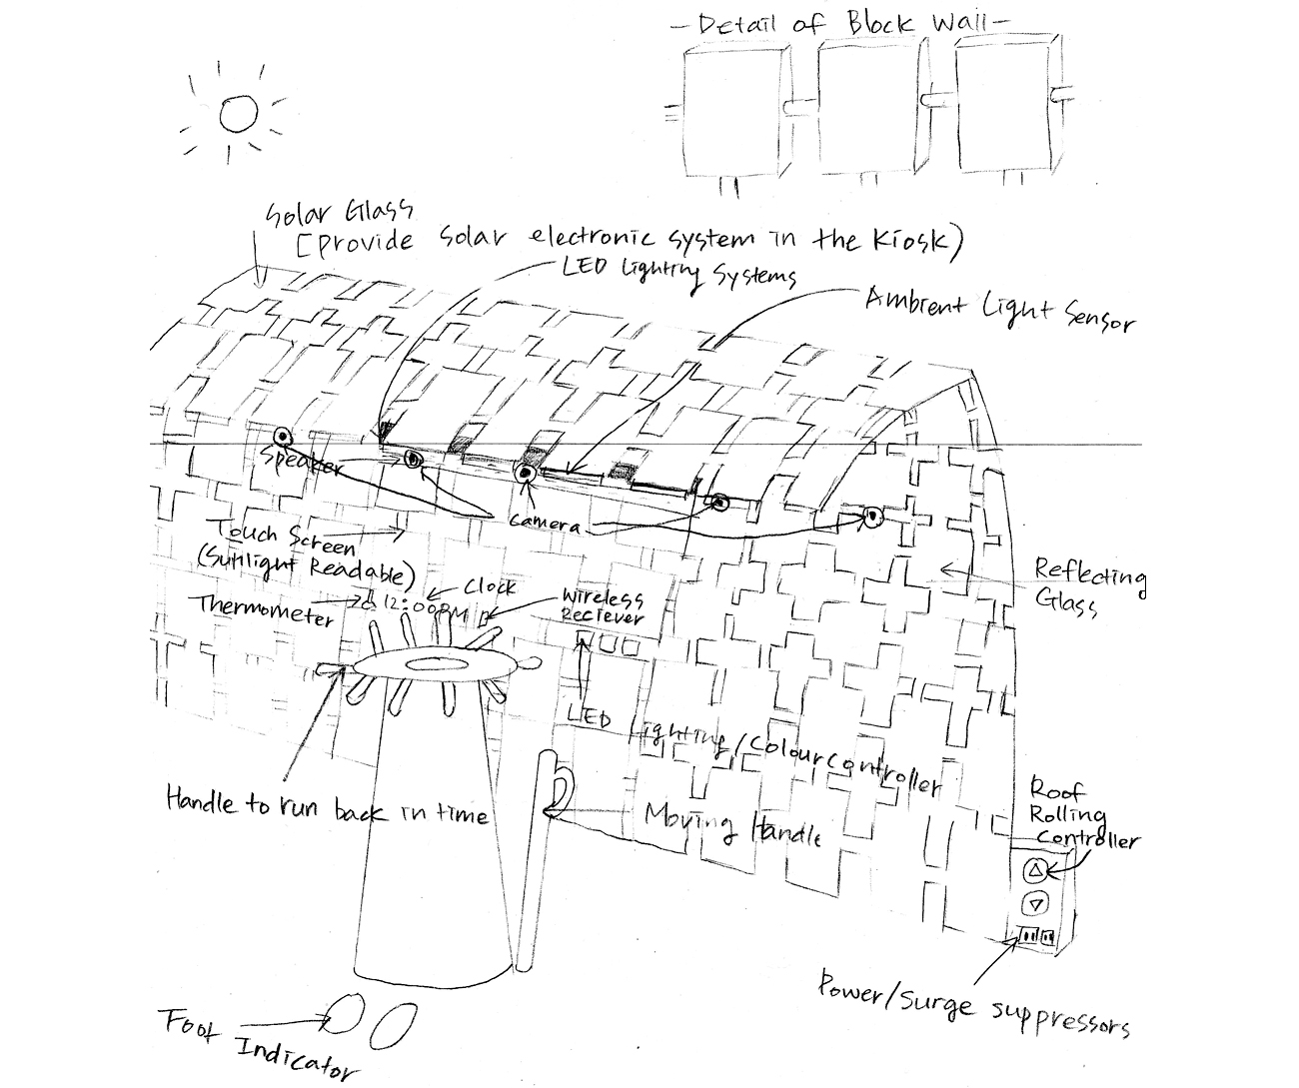
Form Factor
Notes:
Set of connected LCD screens
Small 1” gap between screens
Physical control wheel + lever that can be used to operate the kiosk
Touch screen
Solar panels
Rotating wall

Slide 30
One Week Back
Notes:
Rotates wheel slowly… progresses backward through time one day at a time
Couple sees what the area looked like on their first date… few months ago

Slide 31
Annotated Past
Notes:
Progresses further back in time… large segments at a time
Can click on the screen for detailed information on components within the image

Slide 32
Opposite Weather

Slide 33
Rotating Screens
Notes:
Flip lever,
Rotating the wheel rotates the screens

Slide 34
Ambient Sound
Notes:
Here sounds from the steel mills, or rain

Slide 35
Concept Validation
Speed Dating

Slide 36
Notes:
Went to the site
Presented the concepts to people using the space

Slide 37
Feedback
Form Factor
One Week Back
Ambient Sound
Opposite Weather
Annotated Past
Notes:
Liked the form; Rotation is cool
One Week Back is not useful… I know what it was like then, I was here
Ambient sound would be extremely annoying
Opposite weather is cool… probably would want to check that out
Historical aspect is nice… the further you go back, the more interesting it is

Slide 38
Feedback
Form Factor
One Week Back
Ambient Sound
Opposite Weather
Annotated Past
Notes:
Liked the form; Rotation is cool
One Week Back is not useful… I know what it was like then, I was here
Ambient sound would be extremely annoying
Opposite weather is cool… probably would want to check that out
Historical aspect is nice… the further you go back, the more interesting it is

Slide 39
Concept Selection

Slide 40
Window to the Past
Notes:
Next slide

Slide 41
Window to the Past
12 ft
8 ft
Notes:
Screens curve over the user to keep them engaged
System will show images from the opposite season by default
Navigate through images with the wheel… flip the level to switch
Light sensor: adjust the back light of the display
Temperature sensor: shows images with opposite weather
Orientation sensor: rotates the images to display the correct vantage point
Proximity sensor: won’t hit people

Slide 42
Information Architecture
42

Slide 43
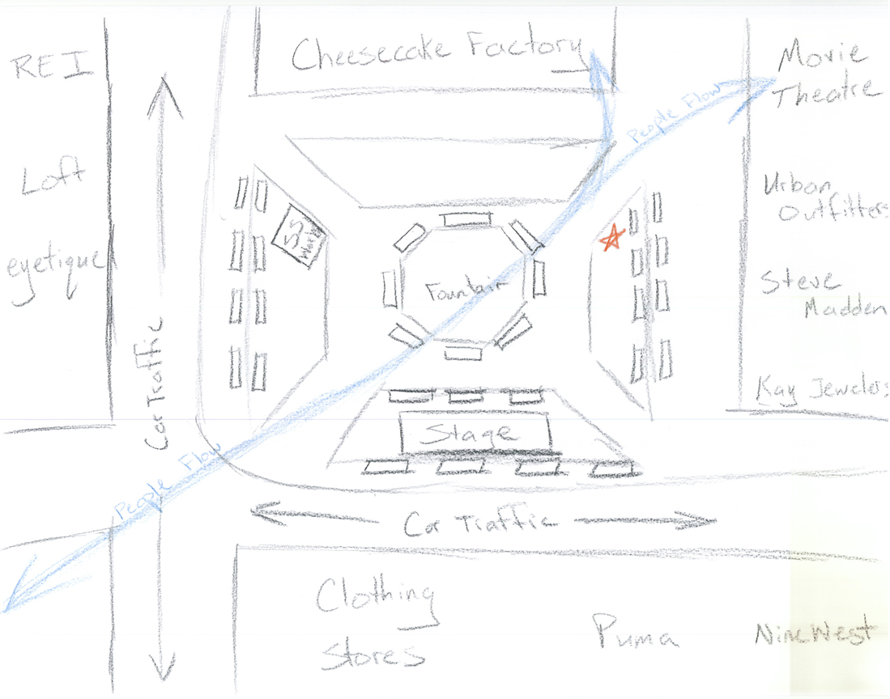
Location within the Site

Slide 44
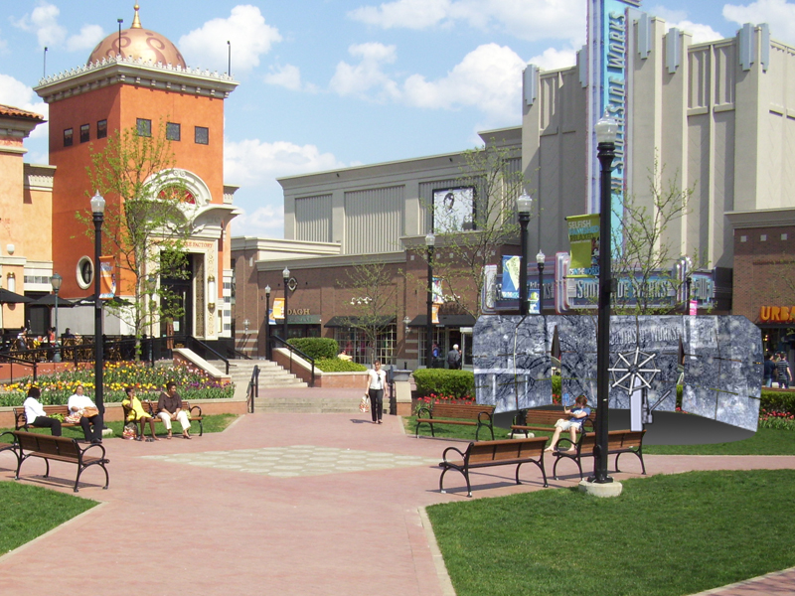
Location within the Site
Notes:
About 20’ circle

Slide 45
Video Sketch

