Slide 1
Gameshow Heaven for Husbands
Team Thundercats MallEntertainment
Alicia | Daniel | Paul | Tobias

Slide 2
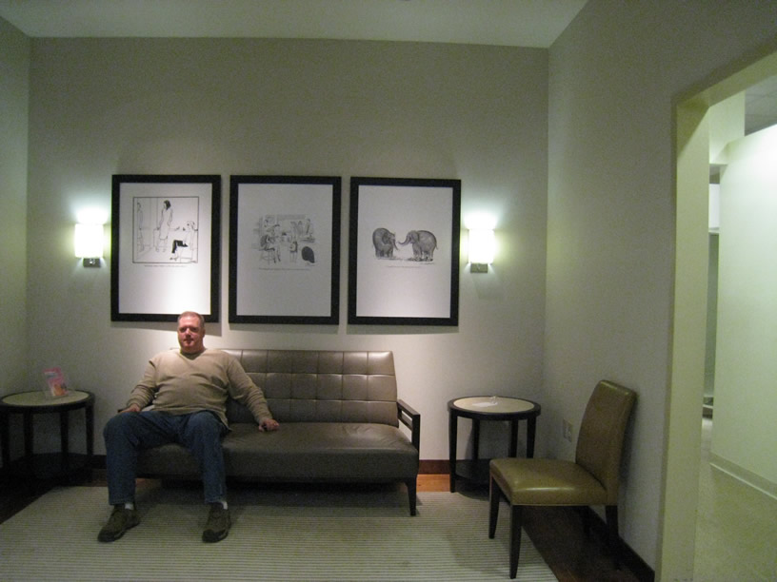
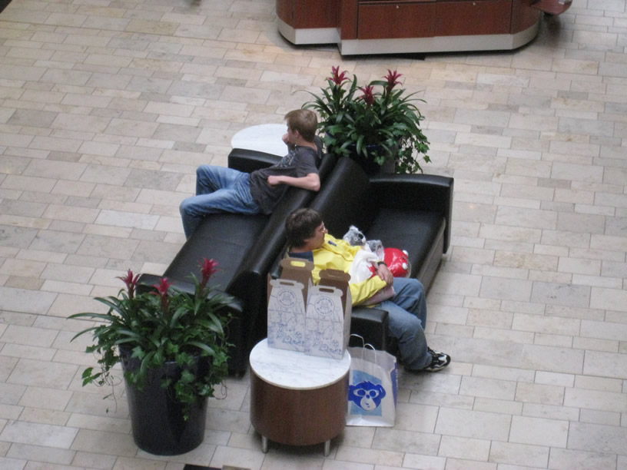
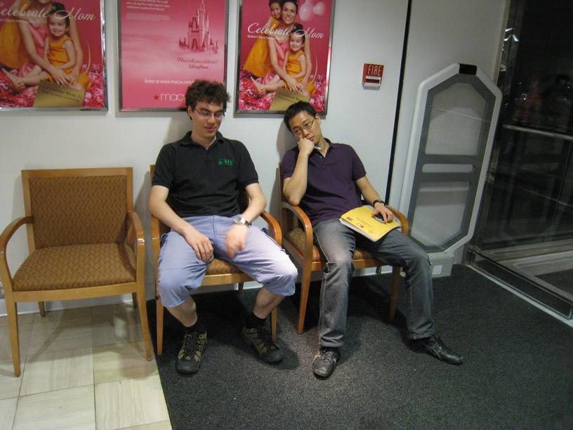
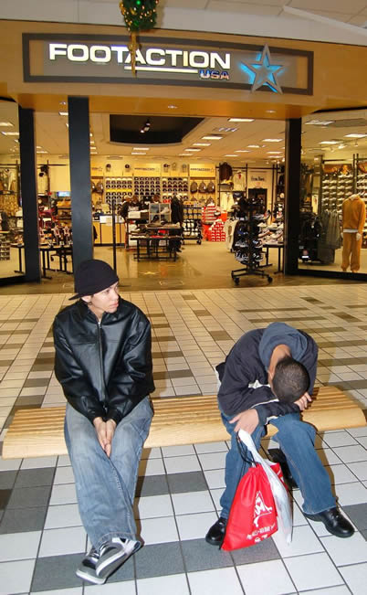
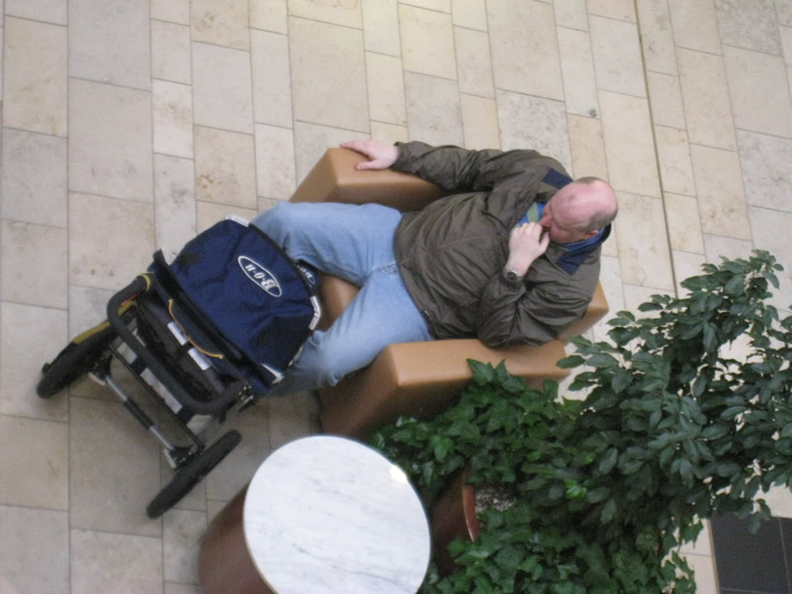

Slide 3
Vision
Make waiting at malls more enjoyable
This will enhance their experience about shopping and their relationship benefits from that
Malls will get more customers

Slide 4
User Research
Observed and interviewed people
Waiting inside of stores
Waiting in common waiting areas
Directed storytelling
How long have you been waiting?
Do you come here often?
Who are you waiting for?
Do you know how long you will still wait?
What are you doing?

Slide 5
Main Activities
"People watching"
Getting something to drink, or thinking about it.
Playing with cell phones.
Thinking about other things they could go and do.
People in groups like to talk to each other

Slide 6
Needs Model

Slide 7
Concept Generation
“Traditional” brainstorming about product ideas
Categories formed (games, drawing, watching, etc.)

Slide 8
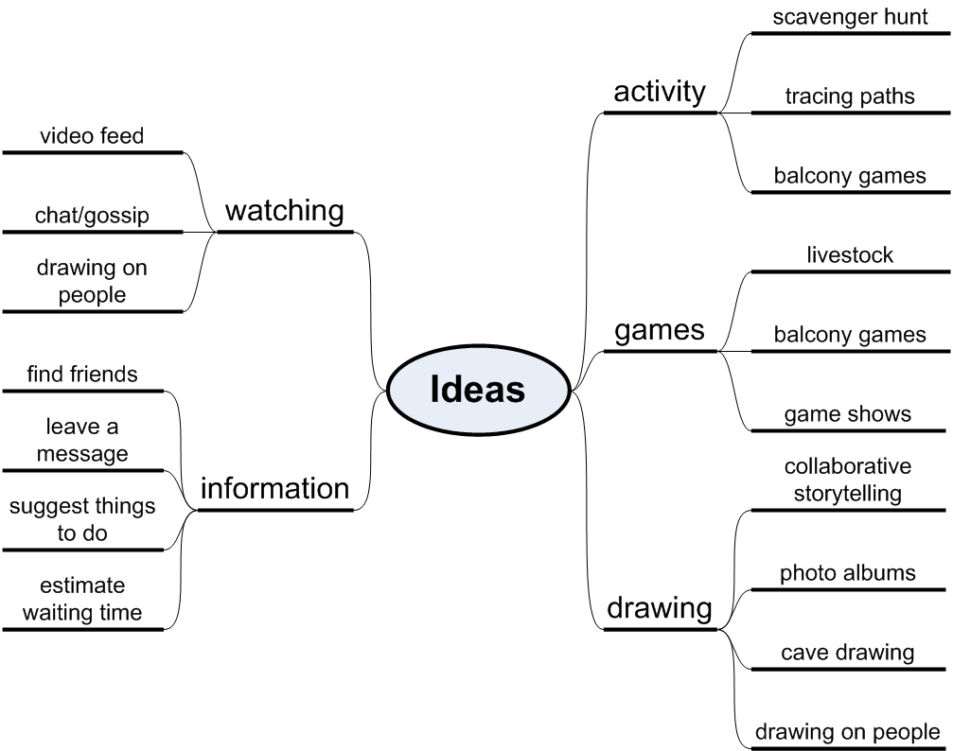
Concept Generation

Slide 9
Concept Generation
Another brainstorming at the mall
To see possible interactions
Formfactors
Also for new ideas

Slide 10
We finally picked…
Livestock
Drawing on people
Tracing paths
Cave drawing
Game shows
Find friends at mall
Estimating waiting time and then Recommend activities
Balcony games
Photo albums

Slide 11
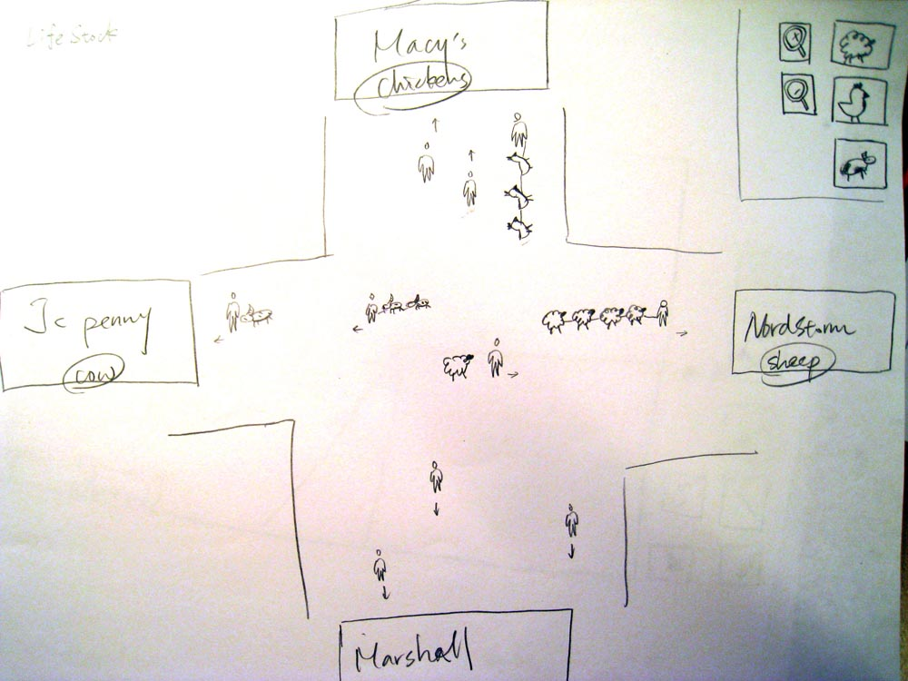
Livestock

Slide 12
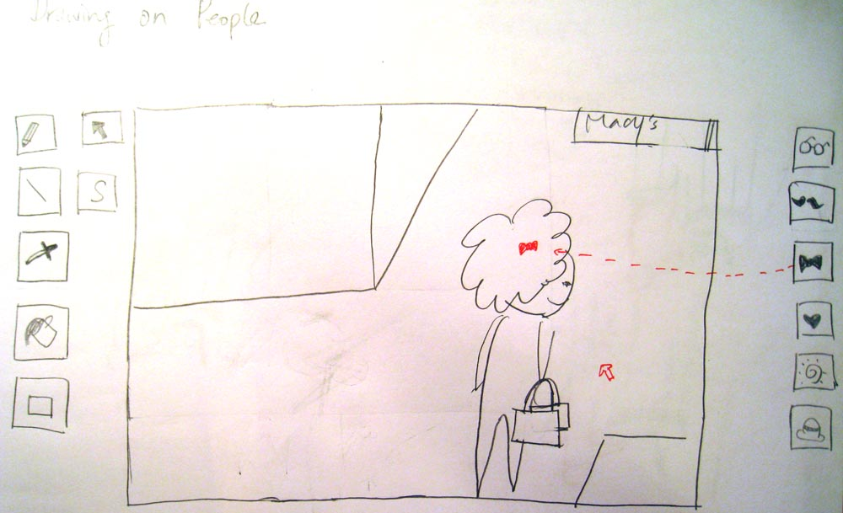
Drawing on People

Slide 13
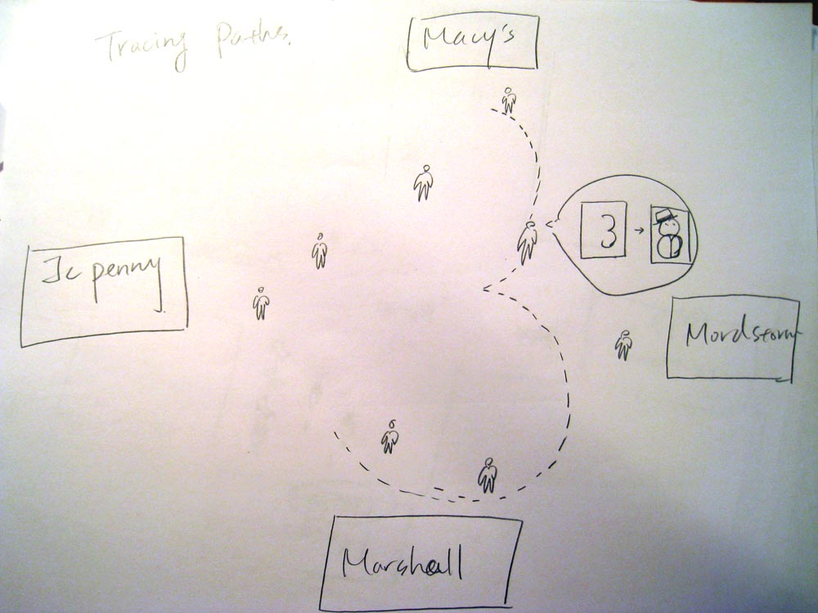
Tracing Paths

Slide 14
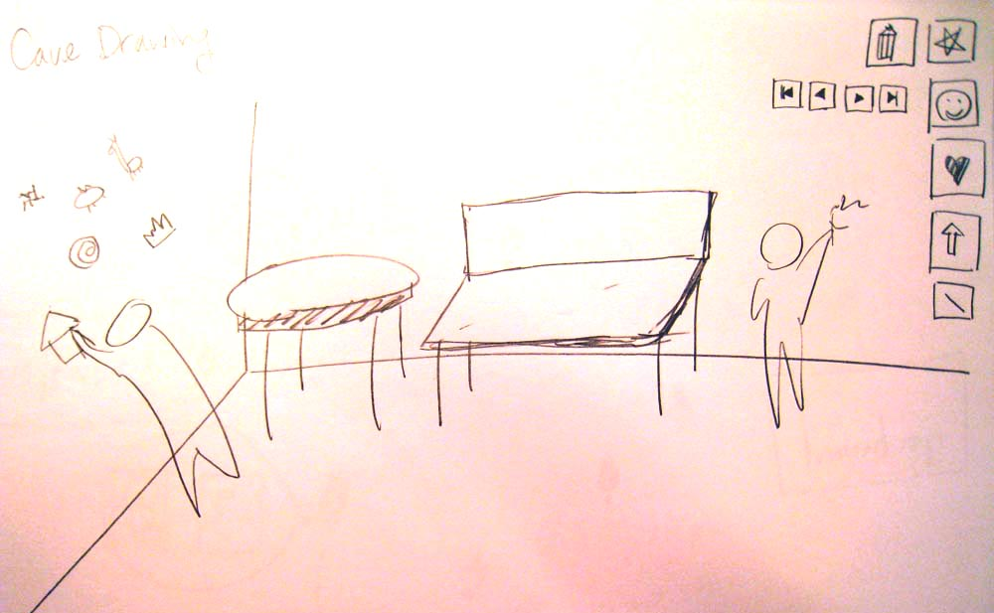
Cave Drawing

Slide 15
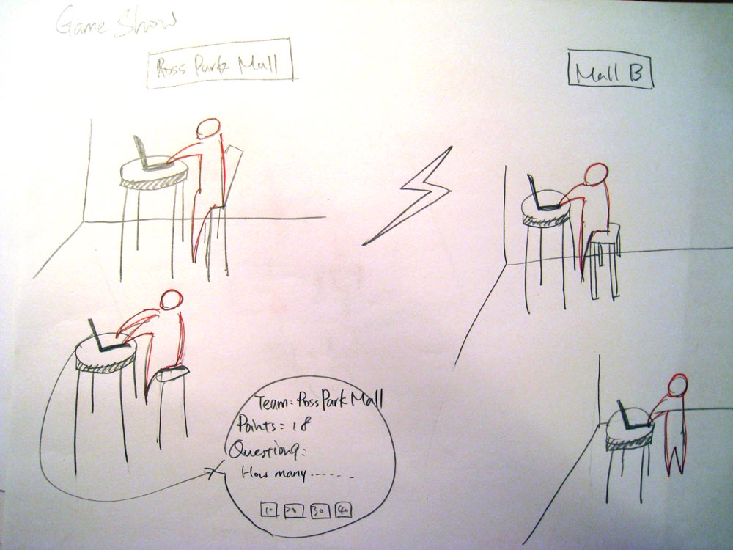
Game Shows

Slide 16
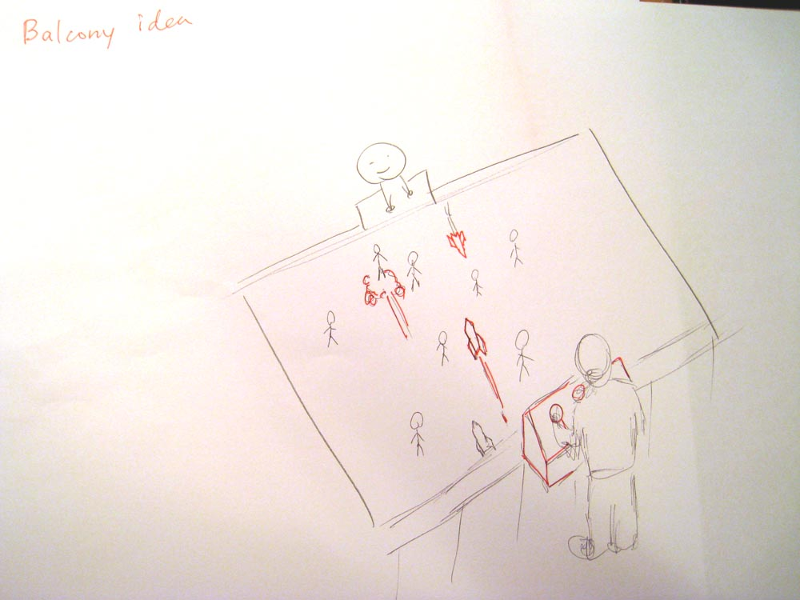
Balcony Idea

Slide 17
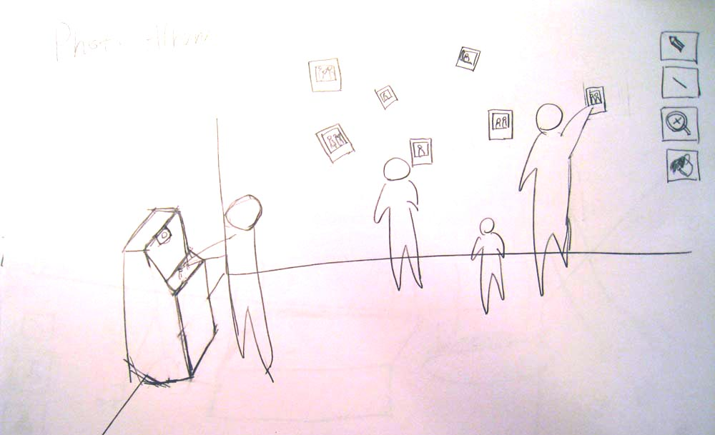
Photo Album

Slide 18
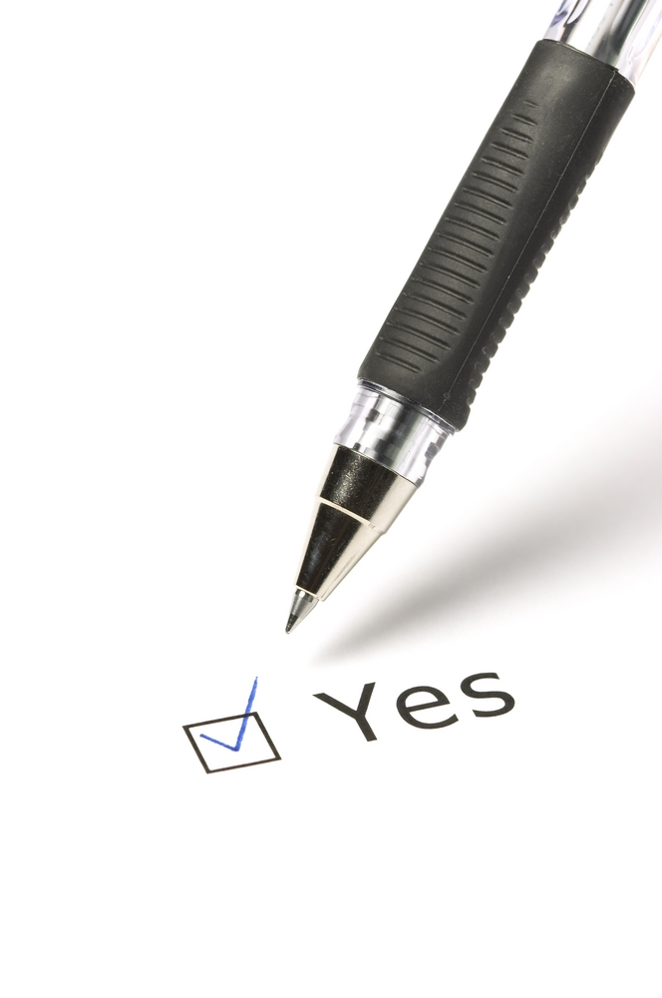
Concept Validation
Presented concepts to class
Used their feedback to prune some ideas
Other ideas were modified based on feedback

Slide 19
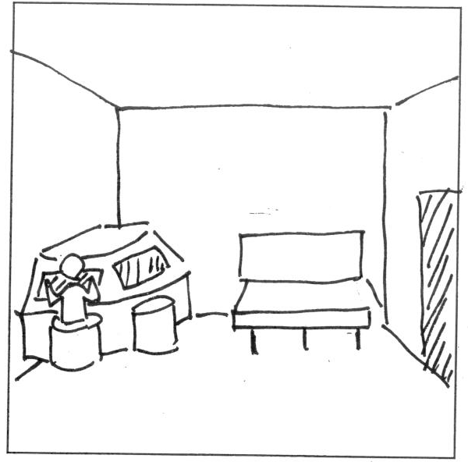
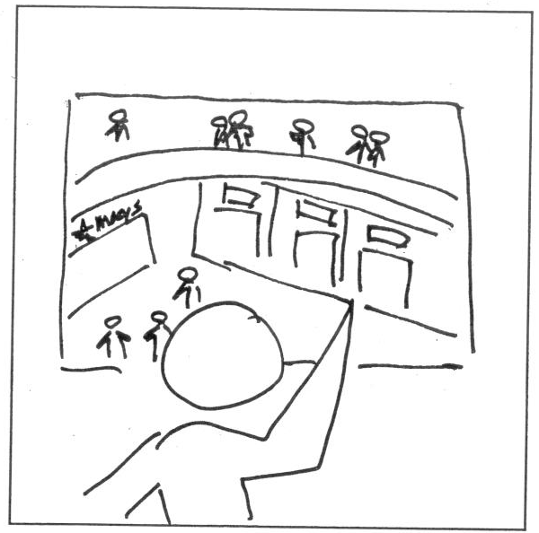
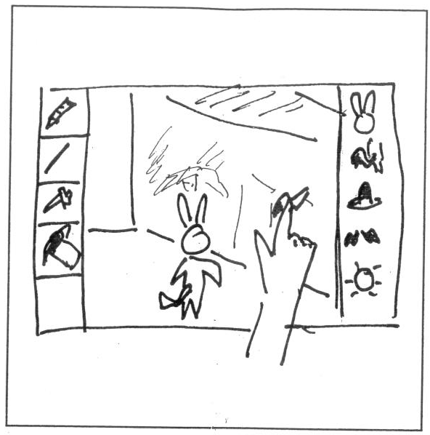
Concept Validation

Slide 20
Speed Dating
We picked the six most promising ideas:
Game Shows
Livestock
Balcony
Cave Drawing / Photo Albums
Drawing on people
Estimating waiting time

Slide 21
At the mall again
We drew a storyboard for each concept
We presented each concept to potential users from our target group
We got people excited about some ideas
We got people to be honest about bad ideas
We got kicked out of Macy‘s

Slide 22
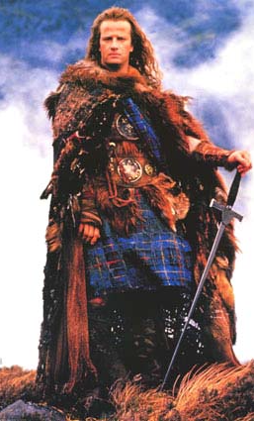
There can only be one…
Speed dating showed two clear favorites
Game shows
No one opposed this idea
Generally very popular among the middle aged people
Drawing on other people
Extremely popular among young adults
Older people opposed this idea

Slide 23
… but which one?
The game show idea is safer, but drawing on people is more innovative
Generated two concepts for the video sketch
Look back at user research
Especially demographics

Slide 24
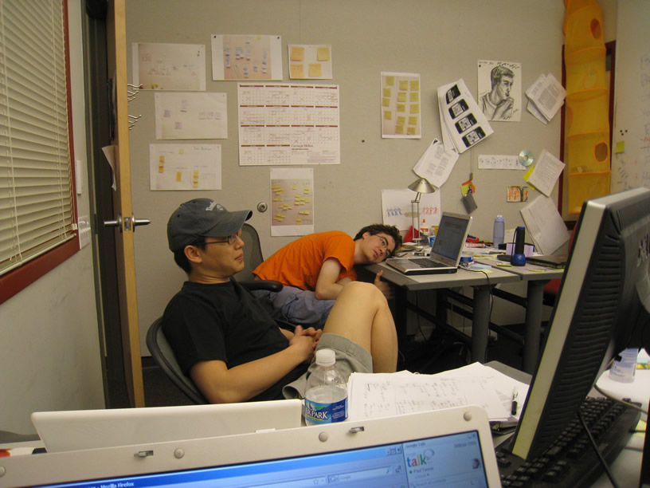
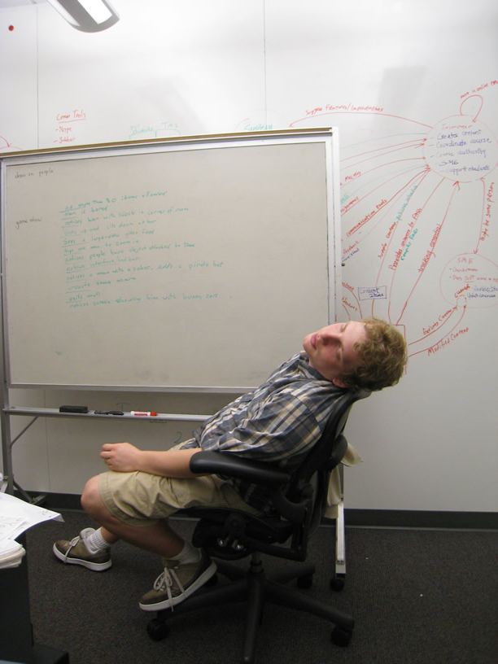
Discussion, discussion, discussion

Slide 25
And the winner is…

Slide 26
Location

Slide 27
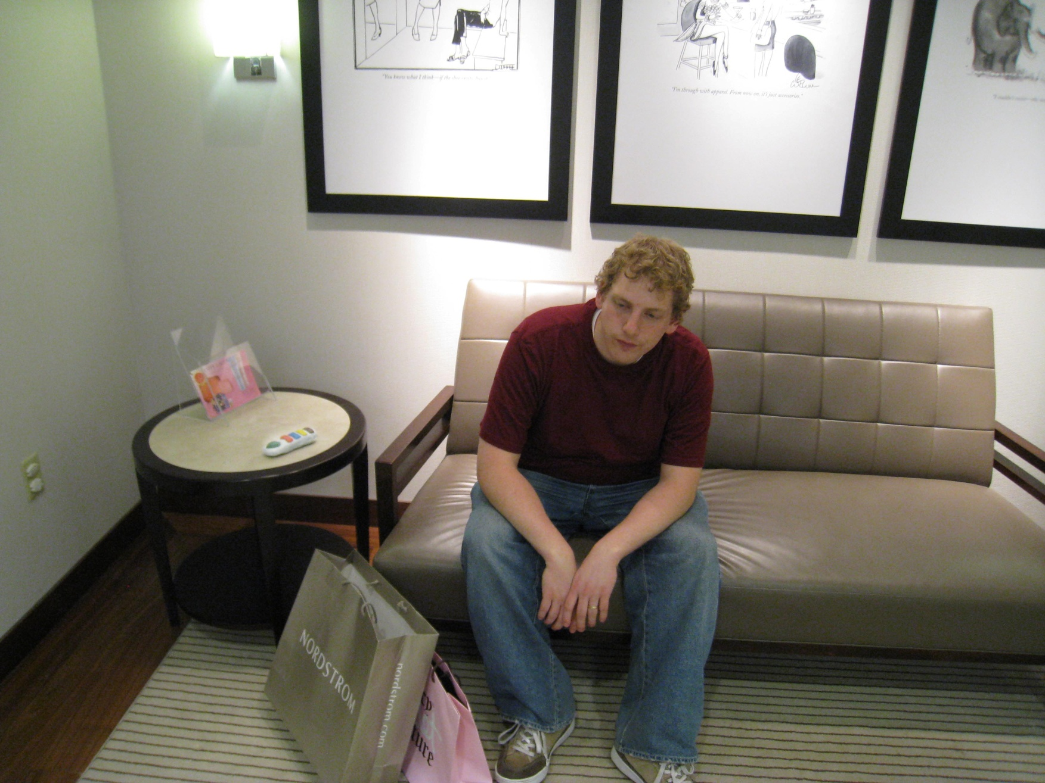
Sensors
touch sensor
pressure sensor
presence sensor

Slide 28
Input/Output
Output:
Speaker
Output:
Screen
(2m x 1.5m)
(6.5ft x 5ft)
Input:
Buttons
Input:
Speech
Input:
Gestures

Slide 29
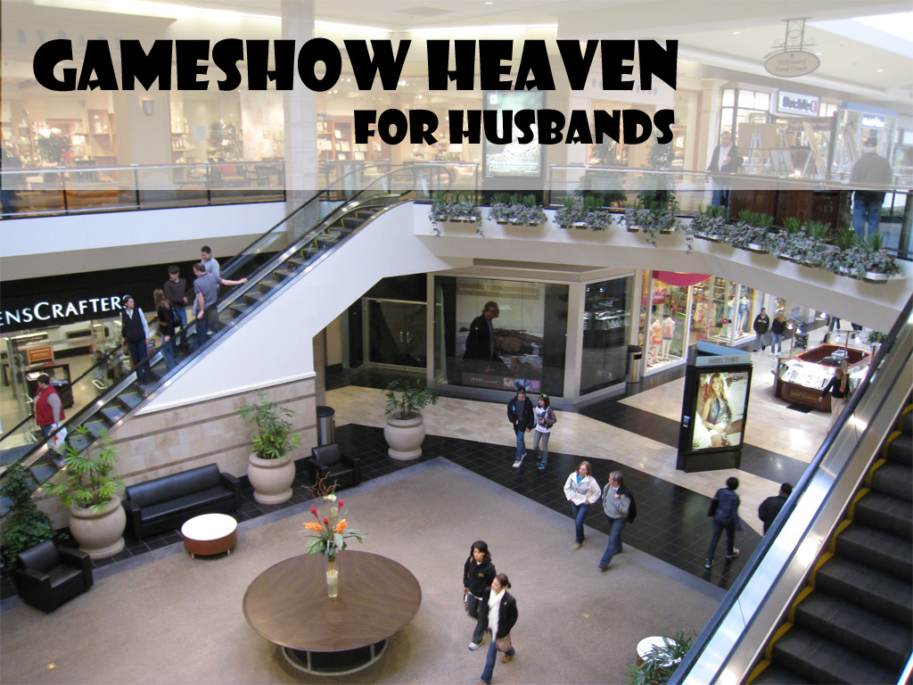
Video Sketch

Slide 30
