Slide 1
JP Arsenault
Jonathan Bidwell
Diya Gangopadhyay

Slide 2
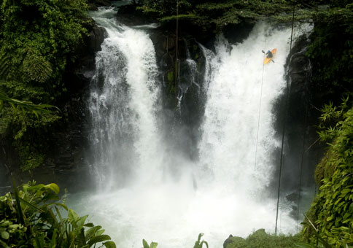
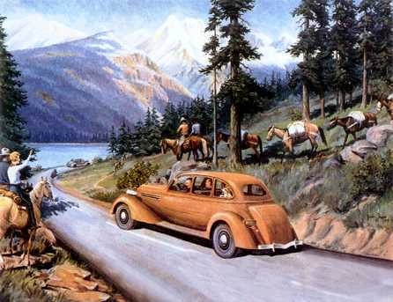
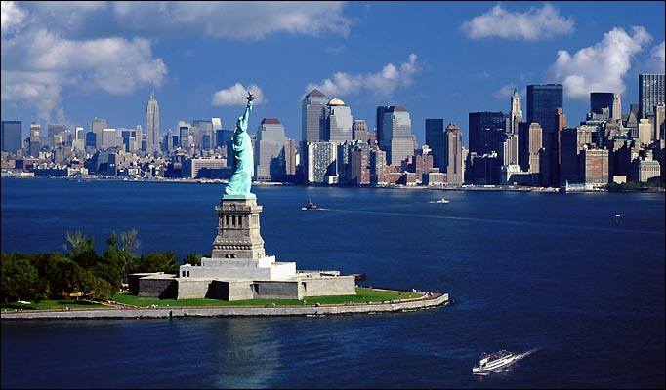
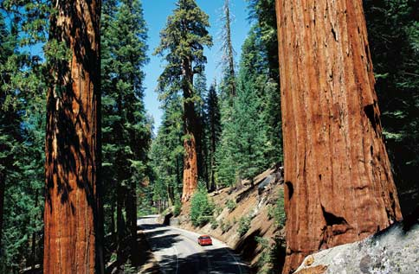
Collecting Experiences
A website that helps build, collect and share the experiences of a place
Gradually led us to explore travel…

Slide 3
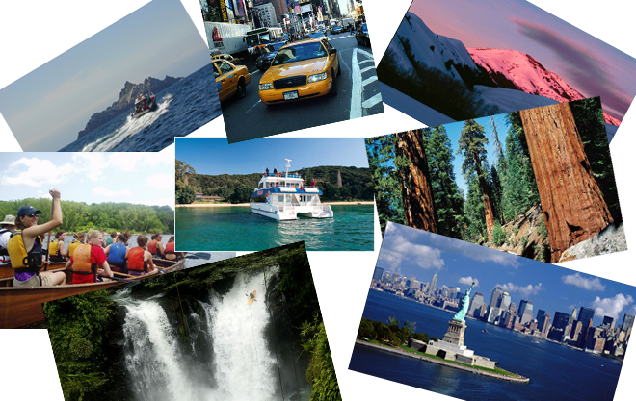
Mood Board

Slide 4
Research Methods
Interviews/Directed Storytelling
Friends and family
Travel Agents
Competitive Analysis
Travel Blogs
Newspapers
Photosynth
Travelogue Sites

Slide 5
Interesting Results
Word of mouth is very important
Quirky places are not as high a priority as we expected
Sharing of photos, videos, etc. is mostly only with family and friends
People don’t necessarily want to worry about the details of a trip, but young people usually don’t use travel agents

Slide 6
Target Market
20-something students:
Limited time for trips
Limited budget
Want good stories to tell their friends and family
Tolerant of breakdowns

Slide 7
Persona
Gianna Russo
20 years old
Studies Comparative Literature at Amherst College
Got the travel bug while a summer student at the University of Leeds
She wants to travel around and experience the Northeast with her friends

Slide 8
Presenting…

Slide 9
Design Model
Possible
Important
Stuff
Planning
Experience
Stuff
Trip
Experience
Sharing
Experience
Feedback

Slide 10
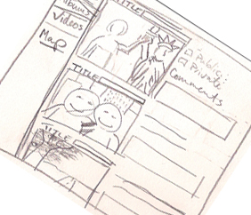
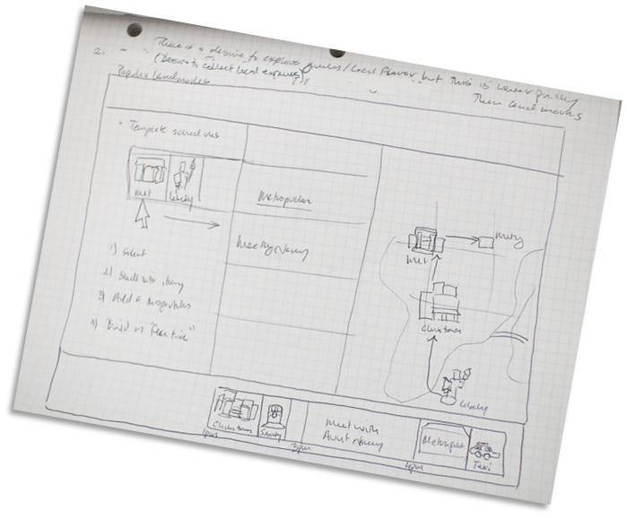
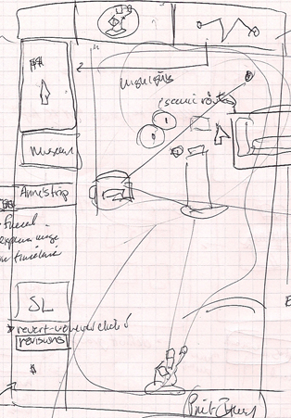
Design Ideas
Word of mouth – through ratings and photo comments
An interactive itinerary builder
Recommending places
Real time itinerary changes
Trip-albums

Slide 11
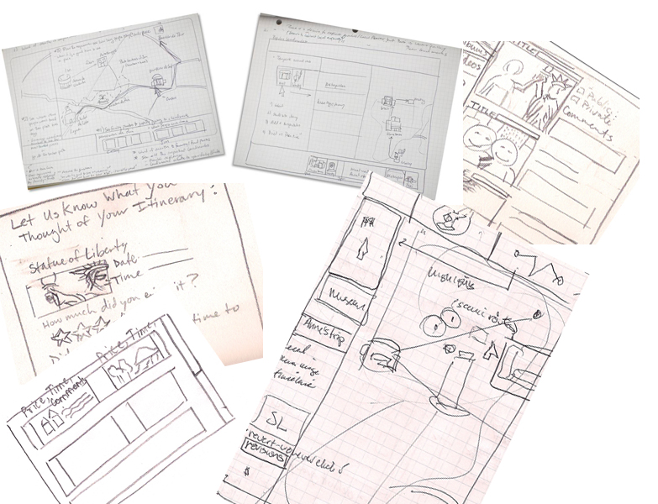
Wireframes

Slide 12
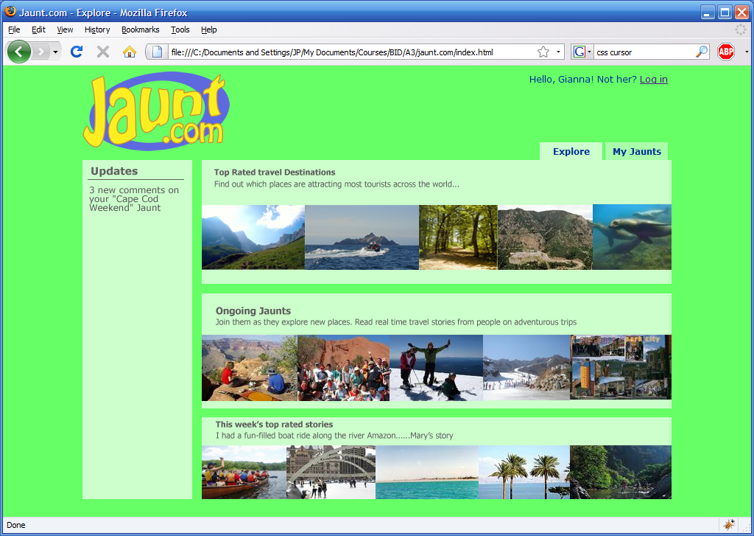
The Final Design

Slide 13
Unique Features
Personalizes the experience planning process
Supports real time itinerary changes
Supports group experiences
Collected experiences inform new experiences

