Slide 1
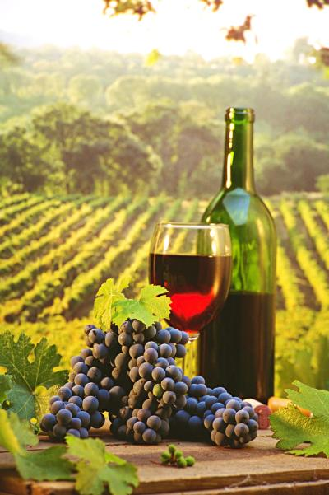
The Everyday Sommelier
A Wine
Recommendation Website
Justine Aylmer | Tobias Freudenreich | Priyanka Shetye

Slide 2
Problem Statement
Create a website for wine recommendation with a personalization aspect

Slide 3
Lori McKay
22 years old
Recently graduated from University of Vermont
First job, marketing department at TelSystems Software
Loves to be on the top of things – be it work, fashion or wines…

Slide 4
Lori’s Story
Her colleagues spoke a lot about wines
She also remembered visiting older brother as a teenager and marveling at his fully stocked wine rack
Thought this seemed very grown-up at that time
Decided she would like to start learning about wine in order to fit in at work and to continue to establish herself as an independent adult

Slide 5
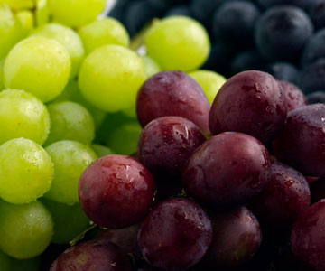
Life Goals:
Be independent
Be perceived as an adult
Experience Goals:
Relate to her coworkers
Feel established in her new surroundings
End Goals:
Be a successful and sophisticated working woman

Slide 6
Research
Competitive Analysis
Decanter.com
Pandora.com
Amazon.com
Directed Storytelling
Novices
Experts

Slide 7
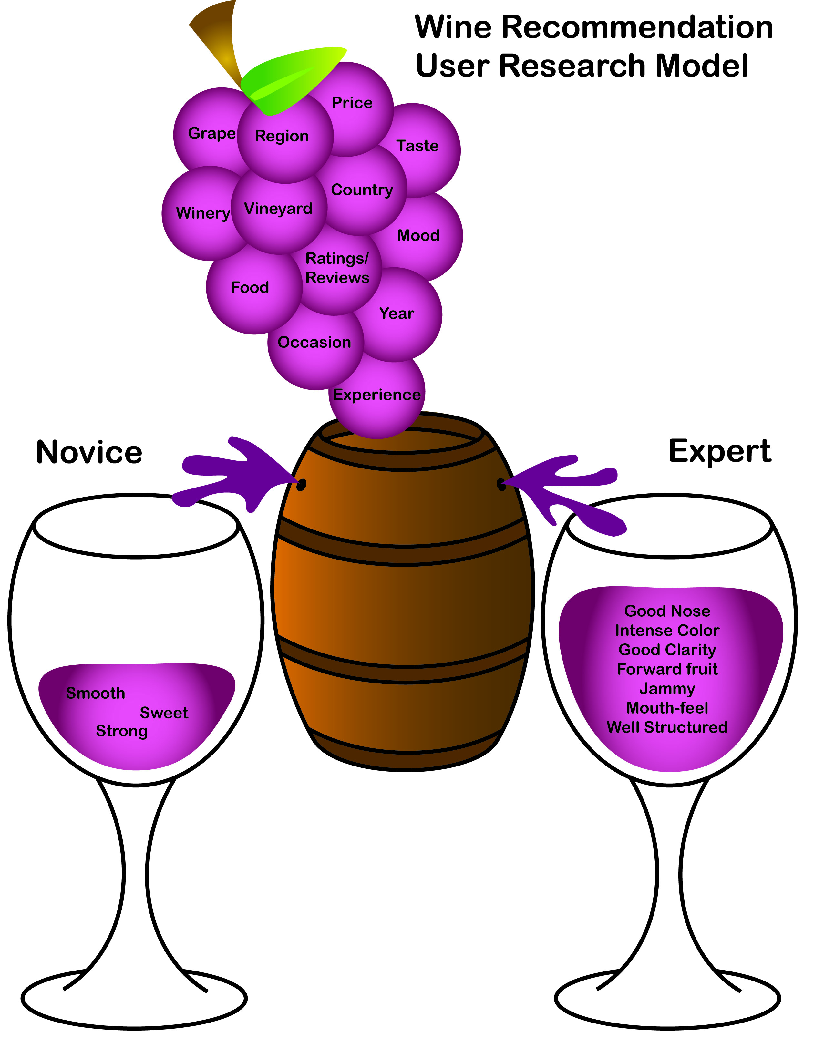

Slide 8
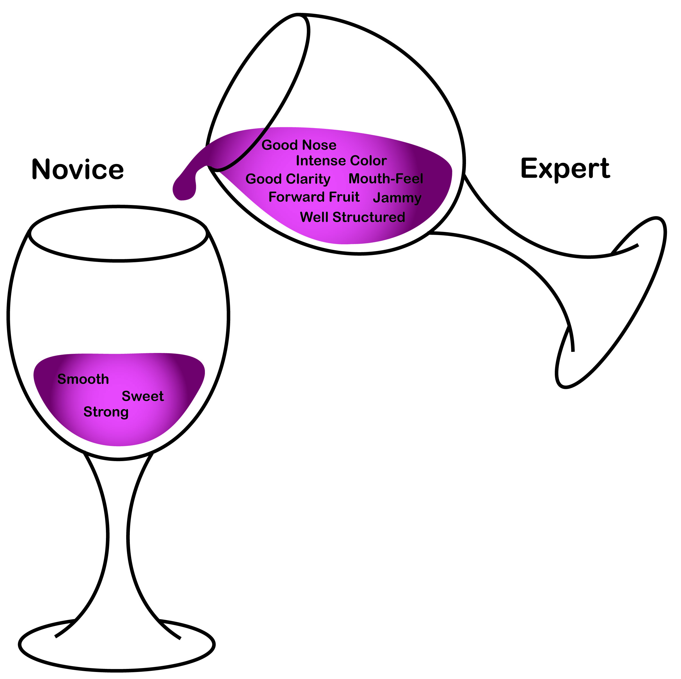
Vision

Slide 9
Lori - The Novice
Lori’s team dinner was coming up towards the end of the month...
Notes:
She wanted to become familiar with wine so that she could discuss it with her coworkers and order wine with confidence when they went out. She grappled with multiple complex books and websites until she stumbled upon…

Slide 11
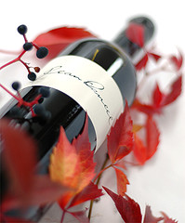
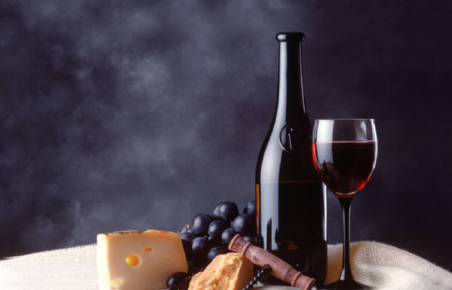
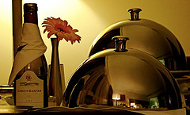
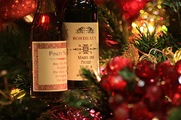
Experiences

Slide 12
Lori – The Expert
Five years later, Lori now has a large collection of wines she likes...
Notes:
She had developed a good understanding of wines and her taste for them. She still uses ‘The Everyday Sommelier’ to keep up with the latest recommendations. Occasionally, she also writes reviews for the on the wines she has tasted to guide the other novice users on the website.

Slide 14
Layout
Home
Log In
Recent Recs
My Wine Book
Create Profile
Search Results
Quick Rec.
Search User Profiles
Enter preferred wines
Get started
Tip of the Day
Reviews
Rate
Learn about
Latest Top ten

