Slide 1
Wazzup?
Mobile Application for finding friends and scheduling events

Slide 2
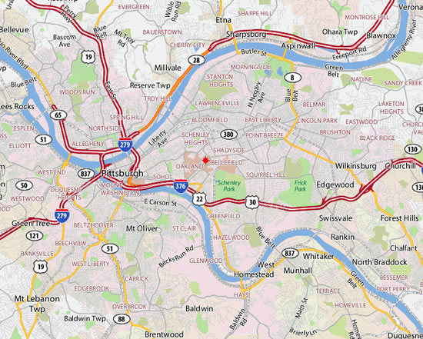
Problem statement
Design a mobile application in which people can find a community meeting place
Meeting place

Slide 3
Problem statement
Done
?

Slide 4
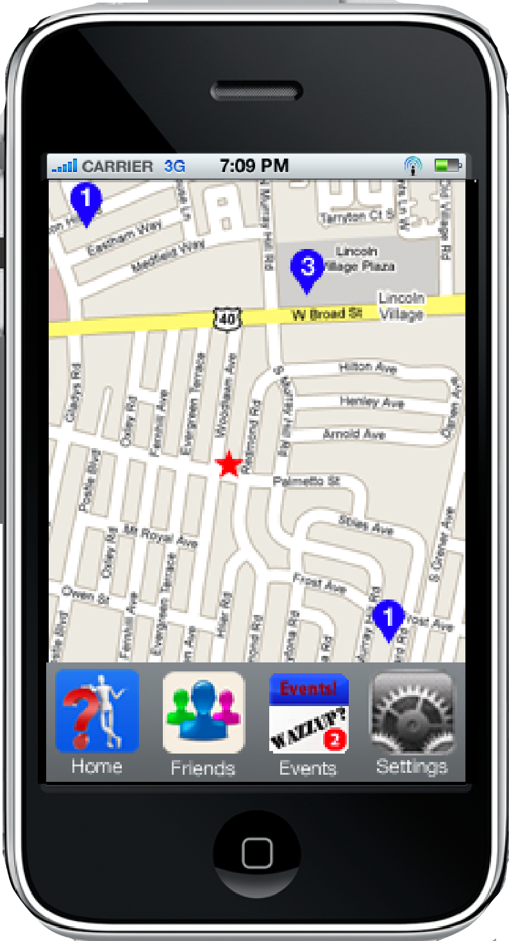
Just a glimpse

Slide 5
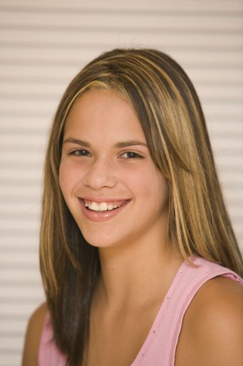
Persona
Vanessa Hayden
Age: 15
  Softball
  Hanging out with friends
  Shopping
  Talking/texting on cell phone

Slide 6

Persona
Parents recently divorced
  Moved to Ohio with her father
  Her brother stays with her mother
She’s new to Ohio
  Wants to find friends
Babysits
  Money: prom dress, popular fashions, etc.
  Reminds her of her brother

Slide 7

Persona
Goals:
Life:
  Be independent of parents
  Make new friends
Experience:
  Feel loved and appreciated
End:
  Become popular among friends

Slide 8
Design process
Used Persona’s goals and needs to brainstorm ideas what the application should do
Grouped these items
Initial sketching of screens on whiteboard
  Lots of modifications
  “Discovery in sketching”

Slide 9
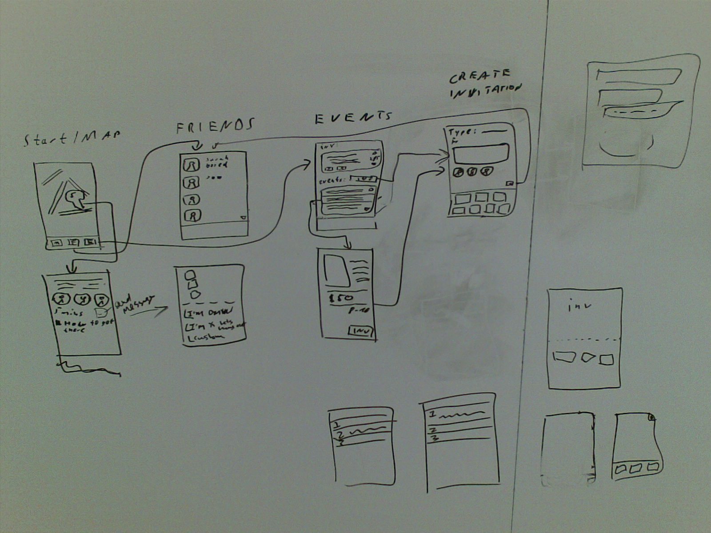
Design process

Slide 10
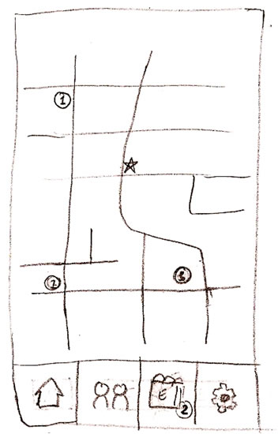
Design process
Map
Notes:
Based on whiteboard wireframes

Slide 11
Design process
Sketched the four main screens (map, friends, events, settings)
Then added the “dialog screens”
Some minor modifications came up

Slide 12
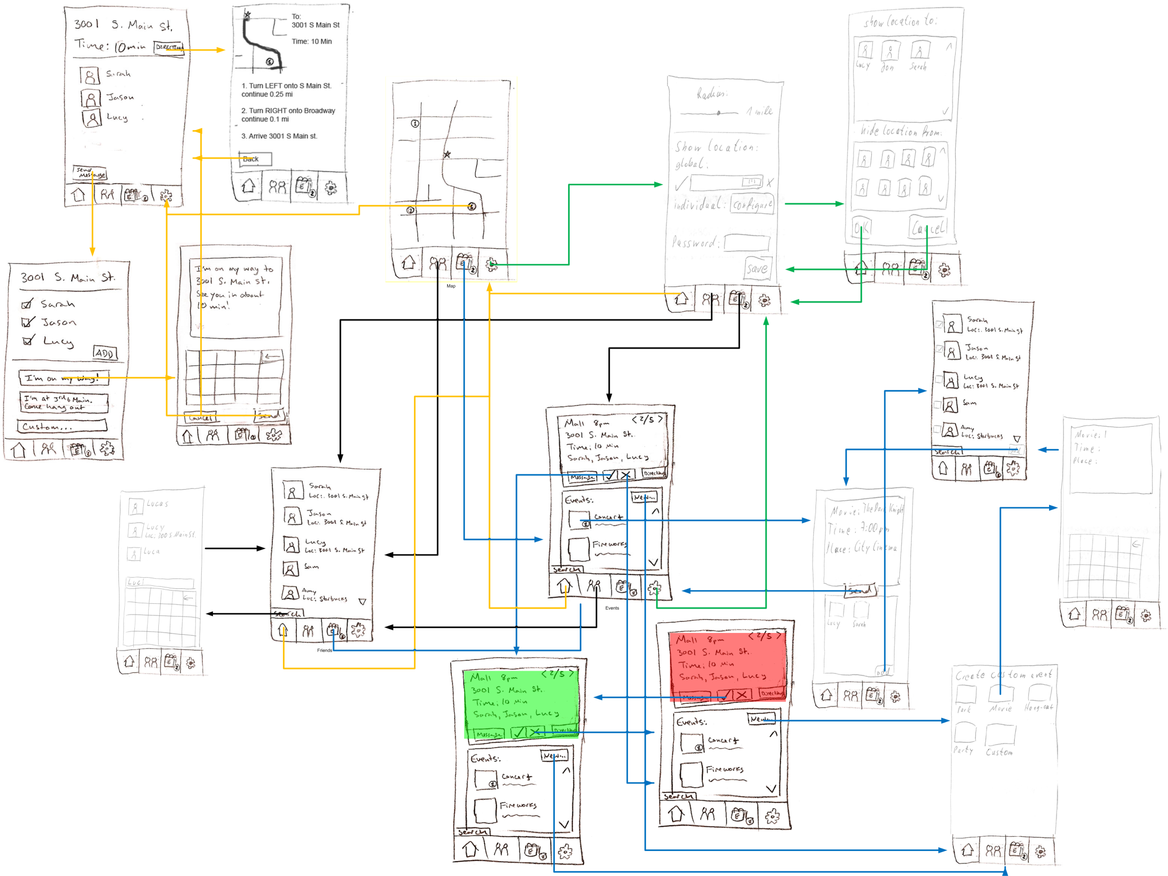

Slide 13

Demo

Slide 14
Thank you!
Questions?

