Slide 2
Problem Statement
To design a mobile application to help elderly mall-walkers to find community meeting place

Slide 3
William Buckner Shields
age: 60
widower
Upper middle class
Goals: Stay fit, meet and interact with new people

Slide 4
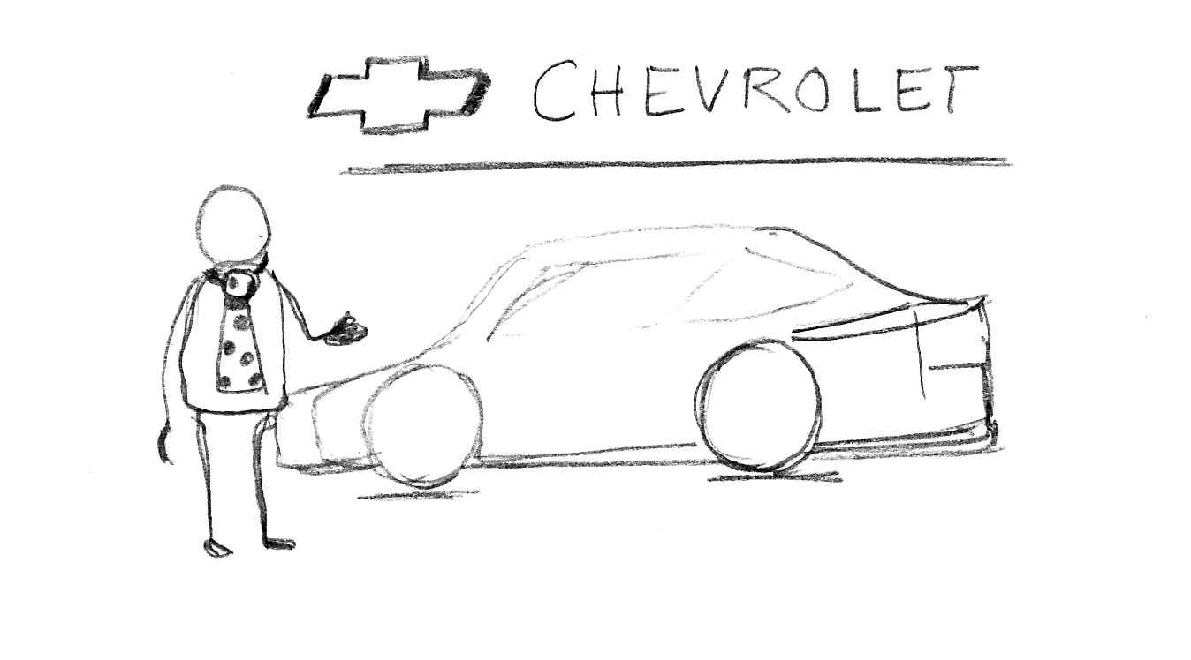
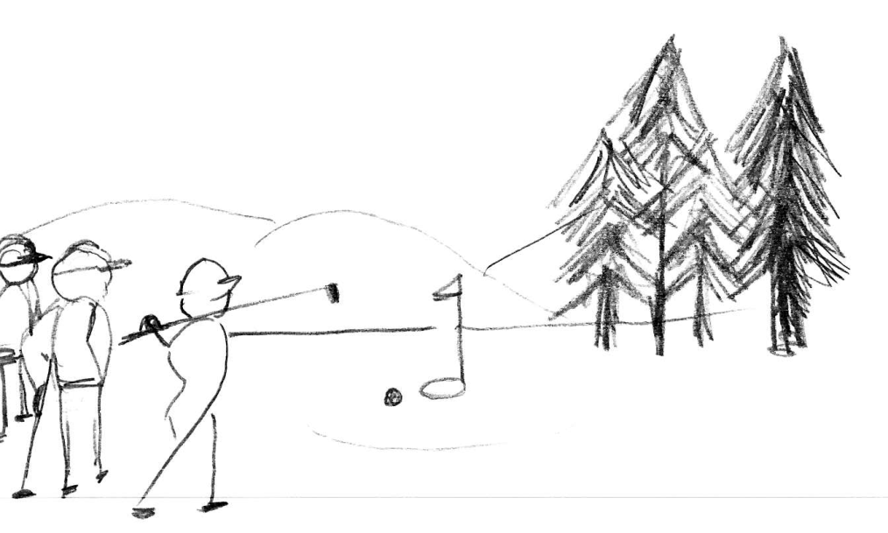
Story
Occupation
Sales manager at Chevrolet, Washington D.C.
Favorite activity
To spend time with friends at company golf club

Slide 5
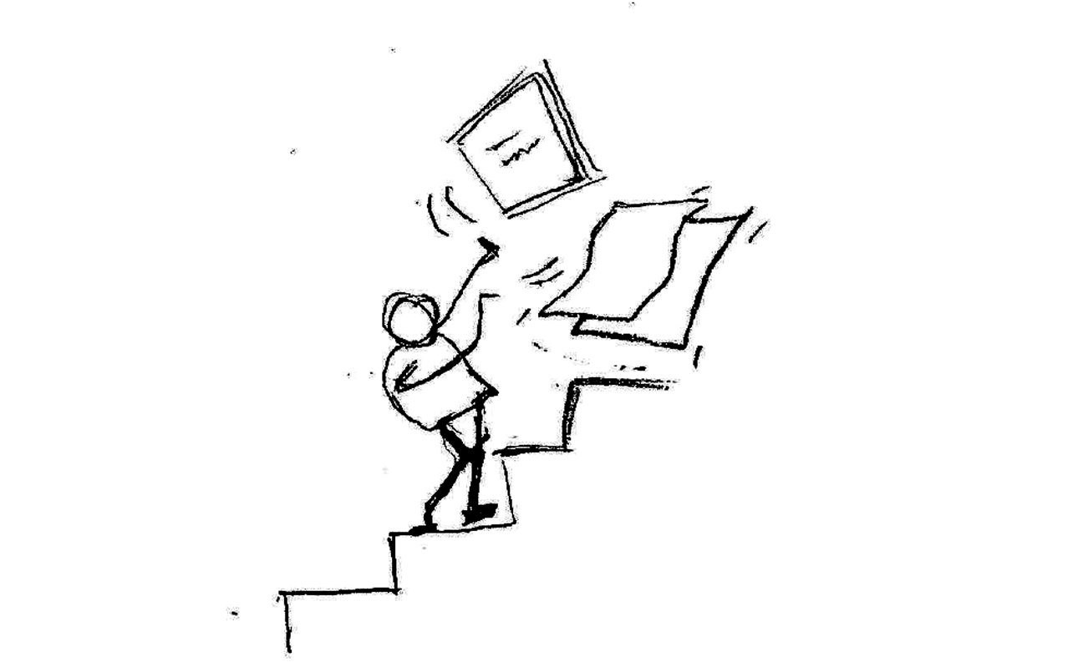
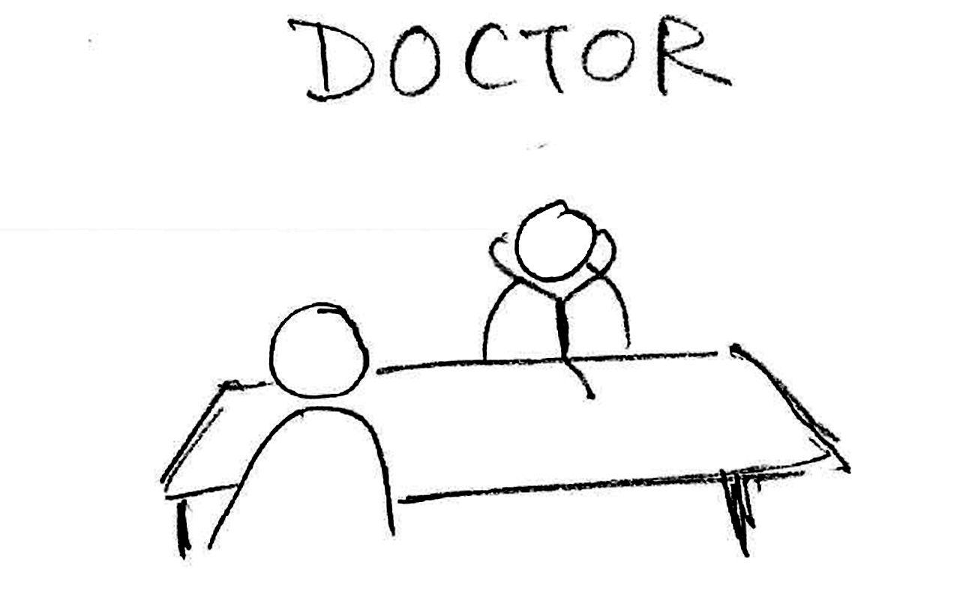
Story
One Year Ago
Heavy workload and distracted, Tripped down the stairs and fractured his leg
You should cut down on work and exercise daily for faster healing

Slide 6
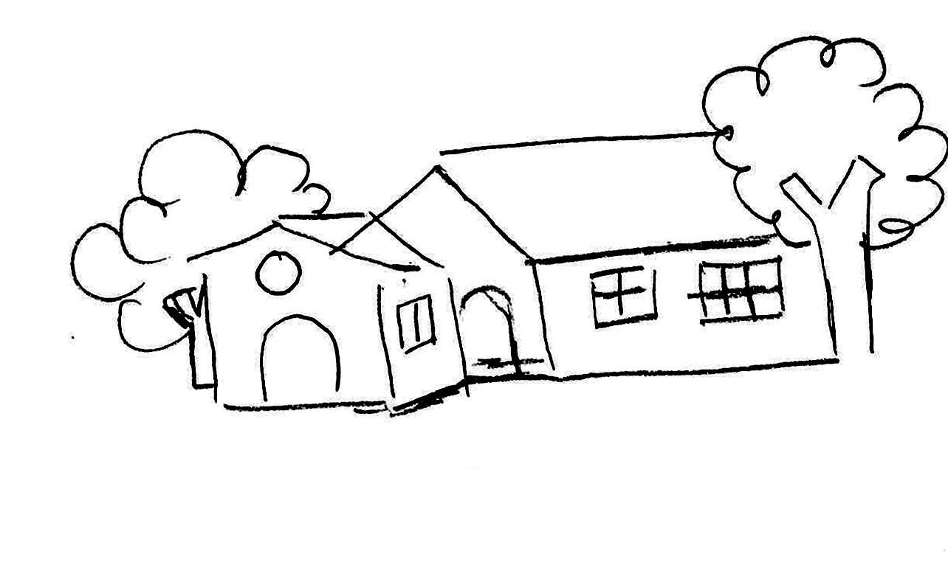
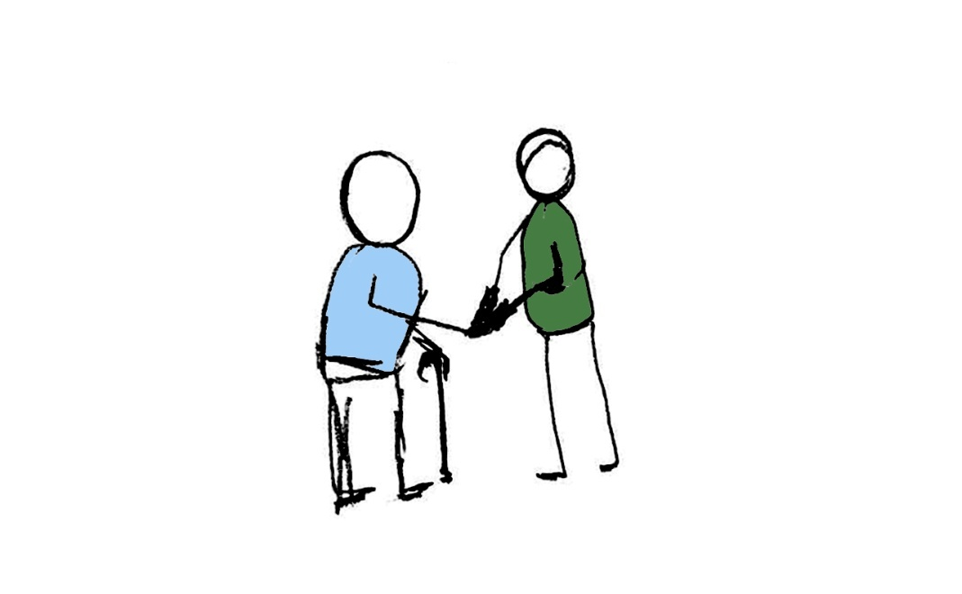
Story
Got an early retirement and moved to Fairfax, Virginia
Hi, I am Bill - your new neighbor. I like to meet new people and I need to exercise as well.
Hi, I am Peter. Why don’t you join our mall-walking club at Waterfront? We start at 8:30 AM tomorrow at East Entrance.

Slide 7
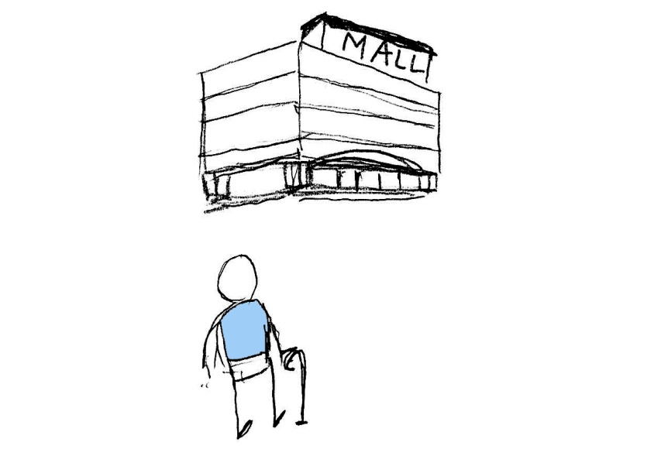
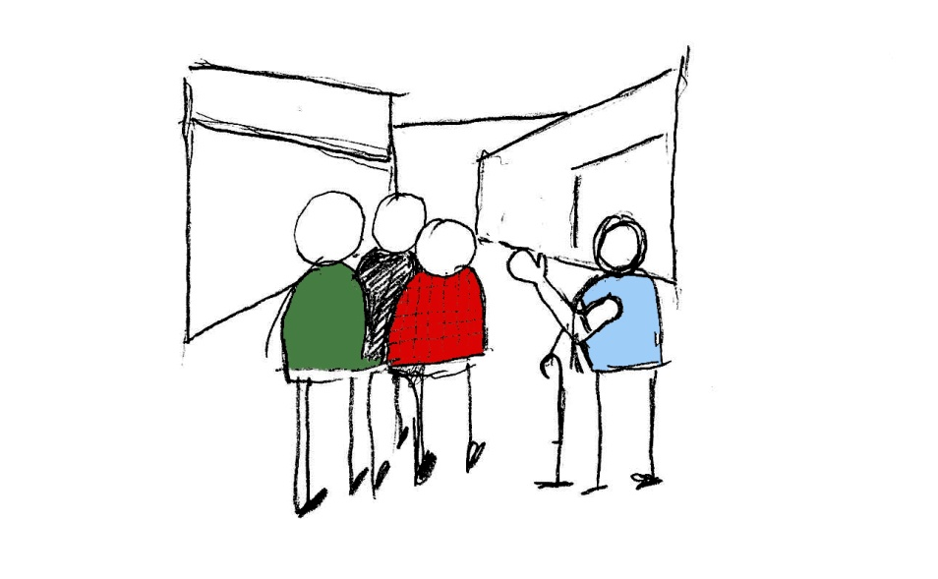
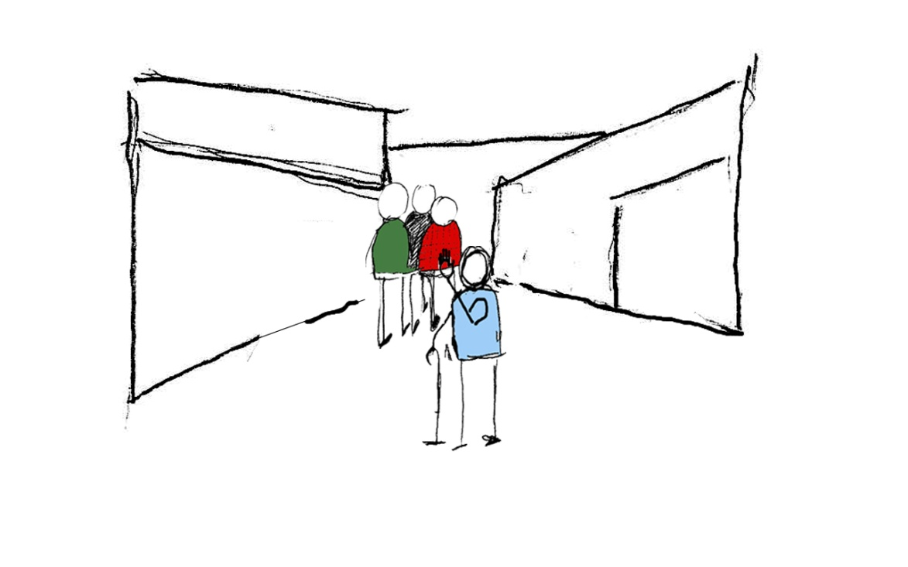
Story
Next Day
Hi everyone, thanks for waiting
I cannot keep up with the group but I do want company.
Who can I walk with and where will I find them?

Slide 8
Problem
Mall-walkers
Have different paces
Want to join and leave at different times
Cannot easily find places and schedule meetings
Hard to find places of interest for other activities
They do enjoy walking and spending time with new people
Notes:
The problem Mall-walkers have right now is :
That they don’t have information on paces of different people
They have to wait for others to join which is time-consuming
It is hard to schedule time and place for meeting
Hard to find places of interest for other activities

Slide 9
Our Solution
Mall*E, an iPhone Application
Form or join walking groups
Members tagged by pace and remaining walking time with suggestions for good fits
Form or join other activity groups
Map facilitates locating other mall-walkers and places like cafes, food courts, lounges

Slide 10
Persona and Scenario Iterations
I also need to buy a belt
Let me check where my buddy Peter is mall walking right now.
Spending time with grand kids
Shopping items
Meeting up with friends
Notes:
For each iteration we developed a problem scenario, discussed possible mobile application solution and then reflected upon how effectively it handled the situation, whether it could be generalized or not and went back to strengthening our Persona and Scenarios.

Slide 11
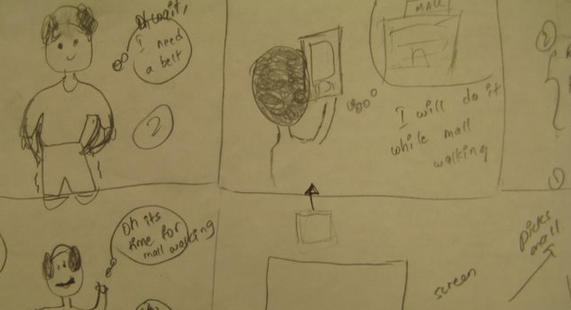
Sketches

Slide 12
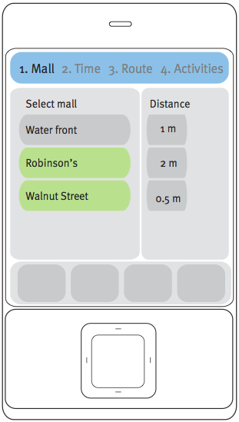
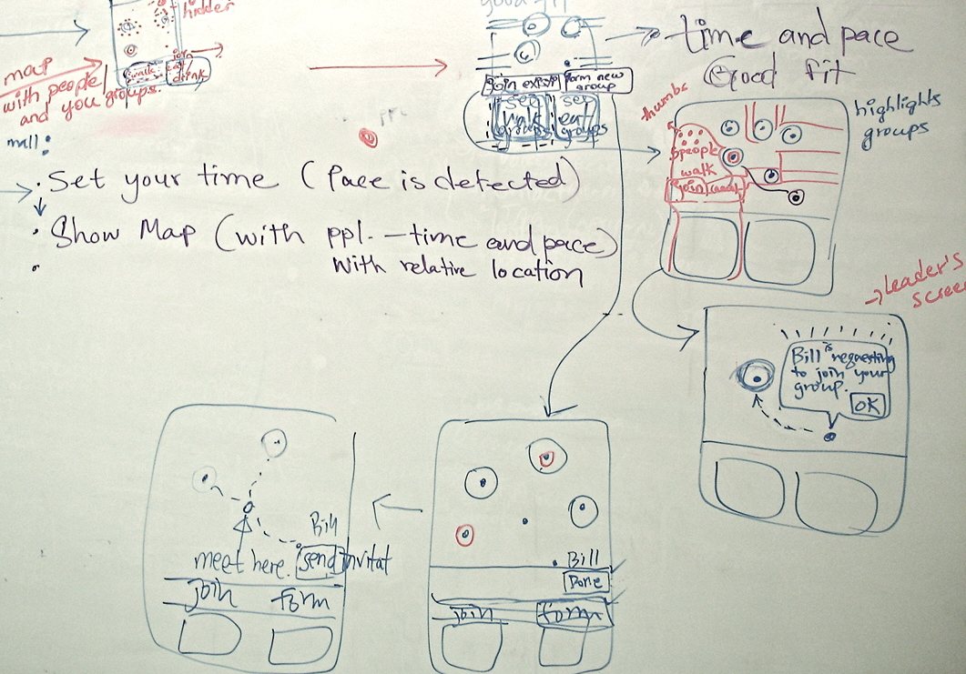
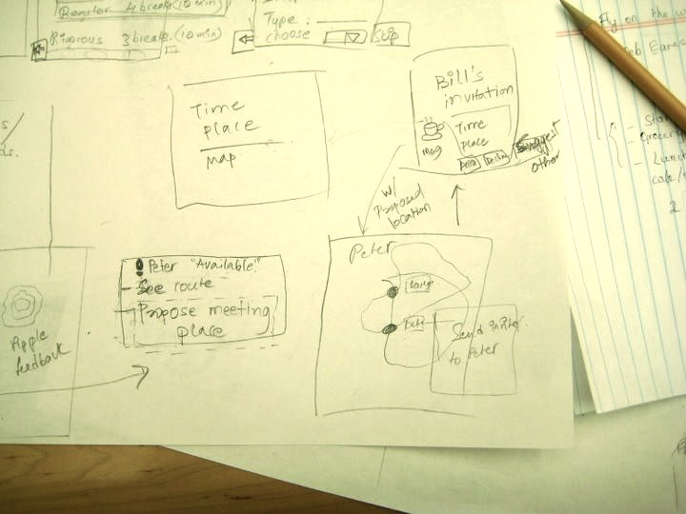
Wireframes

Slide 13
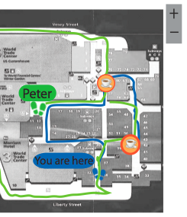
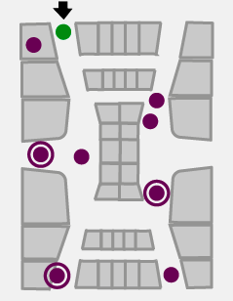
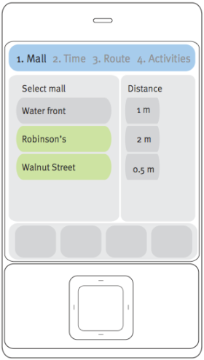
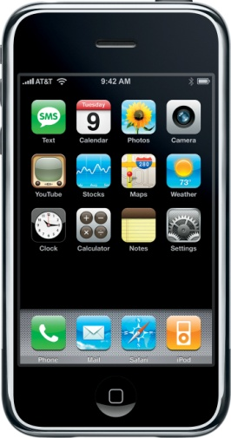
Icons
Group icons
Maps
Phones
Notes:
We put a lot of thought into how intuitive each representation of icons is and what meaning is conveyed

Slide 14
Scenario Guideline
Open Mall E
Set Visibility
Set walking time
Find people with same pace
Invite similar people to walk together
Shake hands with iPhone to form a group
Walk together
Find out ongoing other group activities
Choose an activity and send request to join
Join the group and enjoy

Slide 15
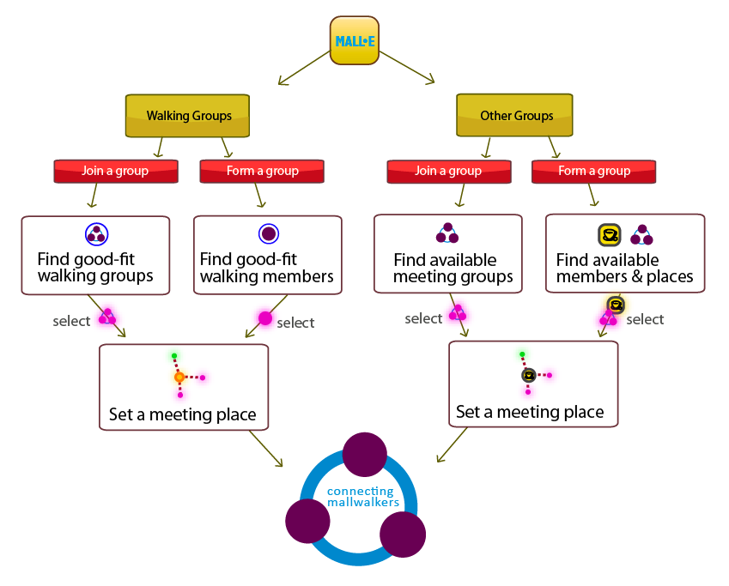
System Overview

Slide 16
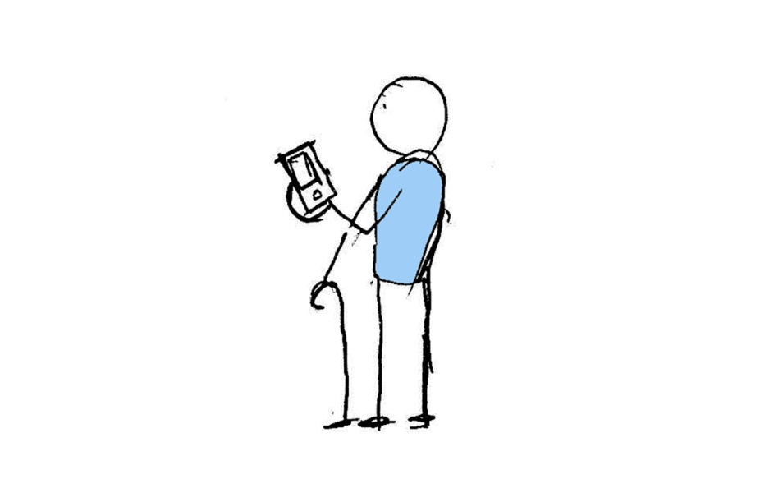
Scenario
Bill goes to the Mall late
Bill uses iPhone to find people to accompany him
Notes:
We put a lot of thought into how intuitive each representation of icons is and what meaning is conveyed

Slide 17
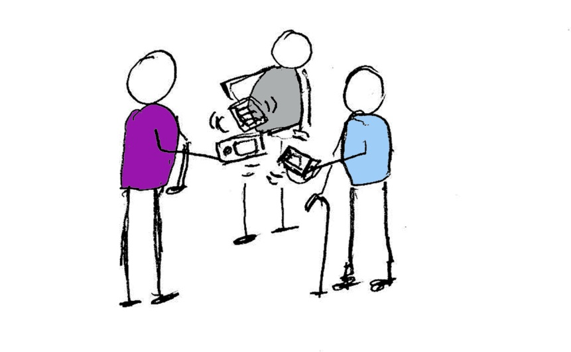
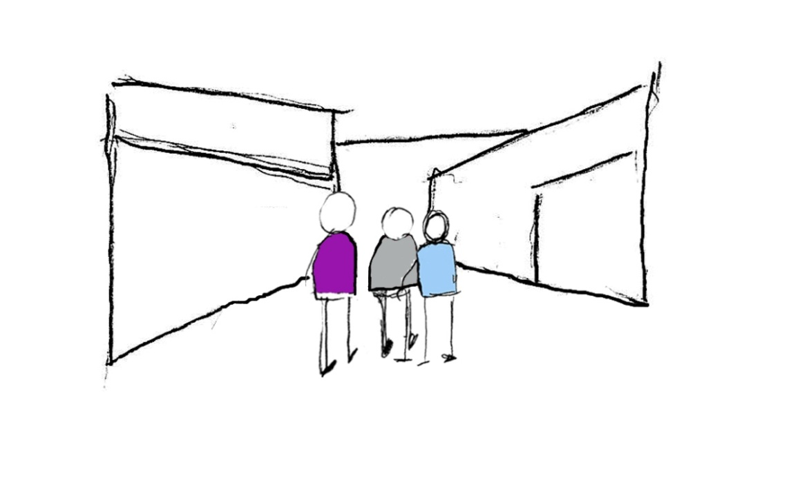
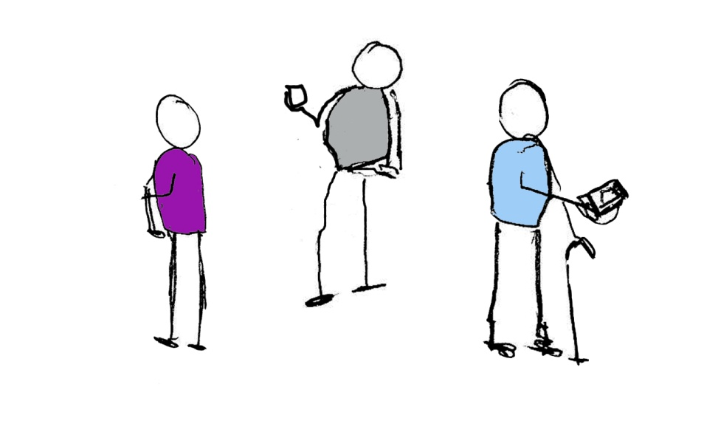
Scenario
Shake hands with iPhone to form a group
Walk together and then go away

Slide 18
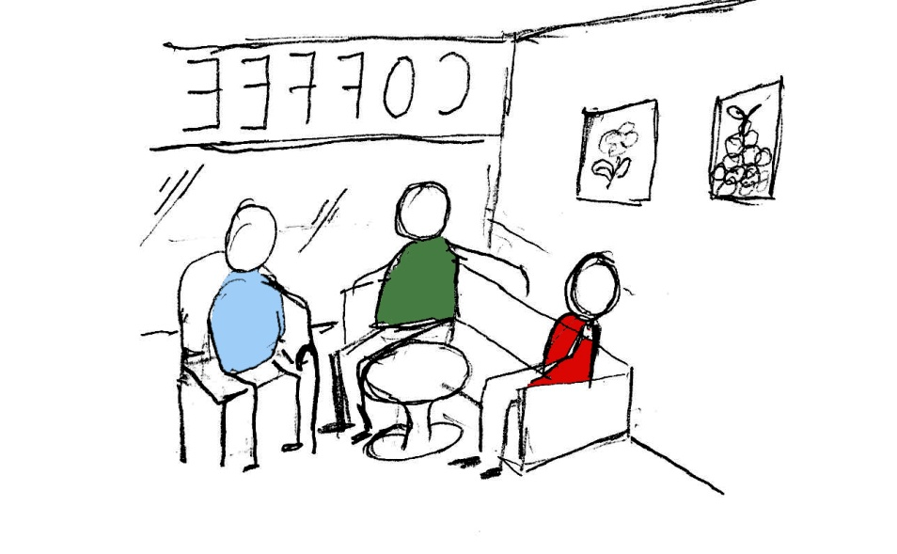
Scenario
Use iPhone to find other activity group like meeting at a cafe
Meet and enjoy talk with friends over a hot cup of coffee

