Slide 1
Basic Interaction Design
A2: Mobile Info System
Persona
M. Azim Ali | François Chu | Kshama Nagaraja

Slide 2
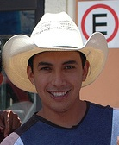
Carreño
Carlos
Crisóstomo
Castillo
29 years old, 5’ 7”, single
Monterrey, Mexico
Hidden piercing
4th of 6 children
2 years at
Universidad de Monterrey
The Guy
M. Azim Ali | François Chu | Kshama Nagaraja
Notes:
2 sisters, 3 brothers (1 younger brother / sister)
1 brother is in the band with him; Very protective of younger sister
Dropped because he no longer wanted to become an accountant

Slide 3
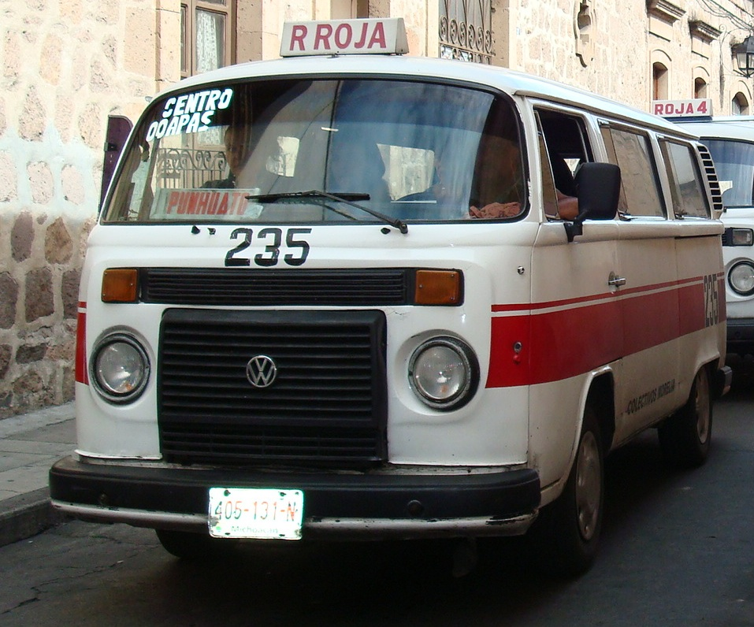
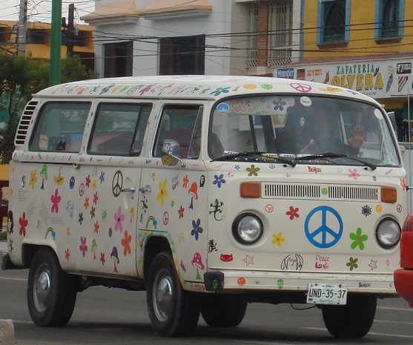
Carreño
Carlos
Crisóstomo
Castillo
Lead guitarist
“The Fathers of Creation”
The ride
Jitney driver by day
Flexible schedules
Extra money
Allows for travel
Lifestyle
M. Azim Ali | François Chu | Kshama Nagaraja
Notes:
Pursued his passion for music playing in bars
Sweet van to drive the band around in
Realized that he wasn’t making enough money to sustain himself so *CLICK* transformed the van into a jitney taxi
Working as jitney driver for about 4 months now; loves it

Slide 4
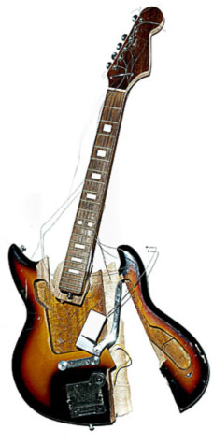
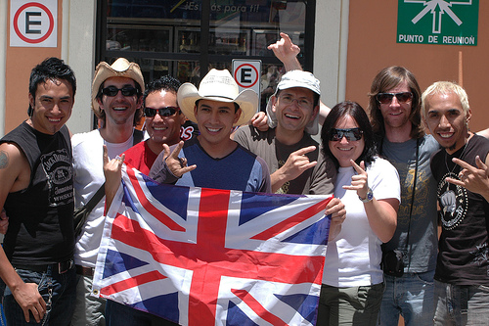
Carreño
Carlos
Crisóstomo
Castillo
Study abroad in Europe
Open-minded, outgoing
Likes meeting new people
Hands-on
Likes gadgets, electronics
Likes fixing things
Doesn’t know how to fix cars
Personality
M. Azim Ali | François Chu | Kshama Nagaraja
Notes:
Passion for underground alternative rock music
Travel
Loves new experiences
Likes to figure out how things work *CLICK*
Not afraid to experiment; breaking things is okay
Important for him to know how to fix cars because he relies on the money

Slide 5
Carreño
Carlos
Crisóstomo
Castillo
Life Goals
Professional musician
Be happy and spread happiness
Lives life on his own terms
Doesn’t want to be tied down
- to one place, career, or woman
Money doesn't drive him
M. Azim Ali | François Chu | Kshama Nagaraja
Notes:
Goes with the flow
Does try to save, and understands the value of having some extra cash

Slide 6
Carreño
Carlos
Crisóstomo
Castillo
Experience Goals
Likes to feel in control
Does not want to feel incompetent
Wants efficient apps
The device is a tool; facilitator
M. Azim Ali | François Chu | Kshama Nagaraja
Notes:
Device should not get in the way

Slide 7
Carreño
Carlos
Crisóstomo
Castillo
End Goals
Tell me what’s wrong
Show me how to fix it
Tell me where to go if no repair is possible
M. Azim Ali | François Chu | Kshama Nagaraja

Slide 8
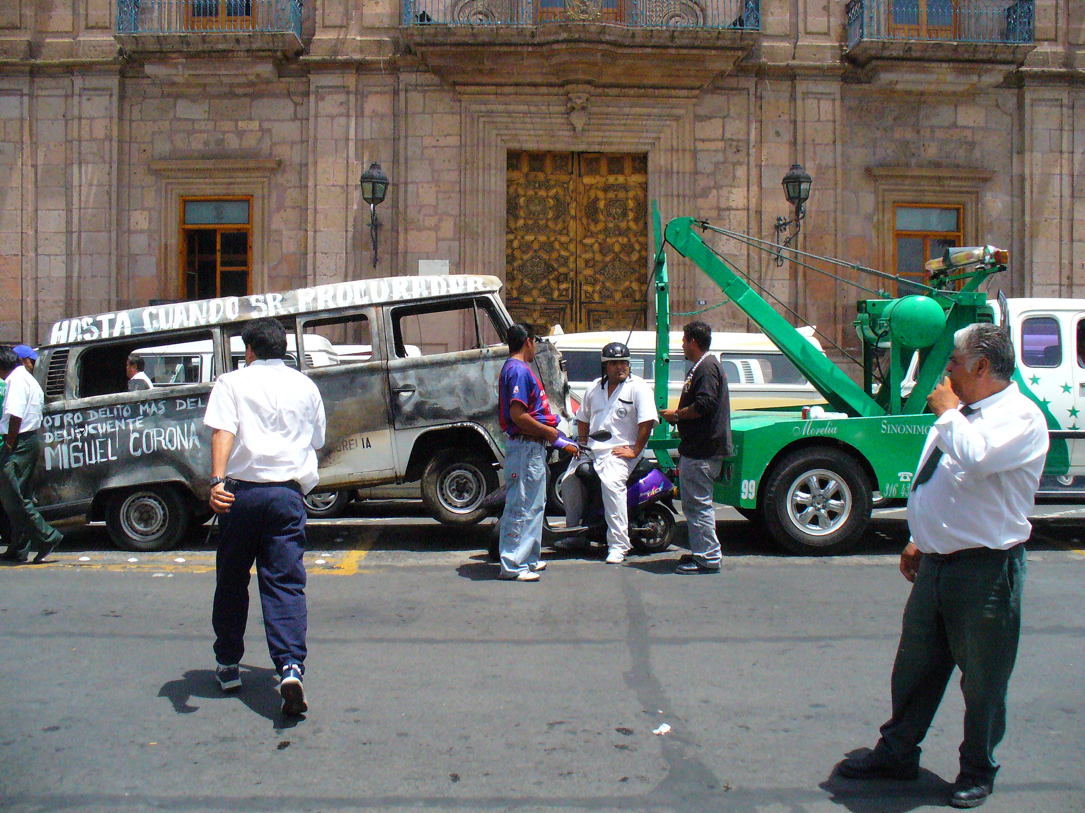
?
M. Azim Ali | François Chu | Kshama Nagaraja
Notes:
Comments or questions?

